Slide 1
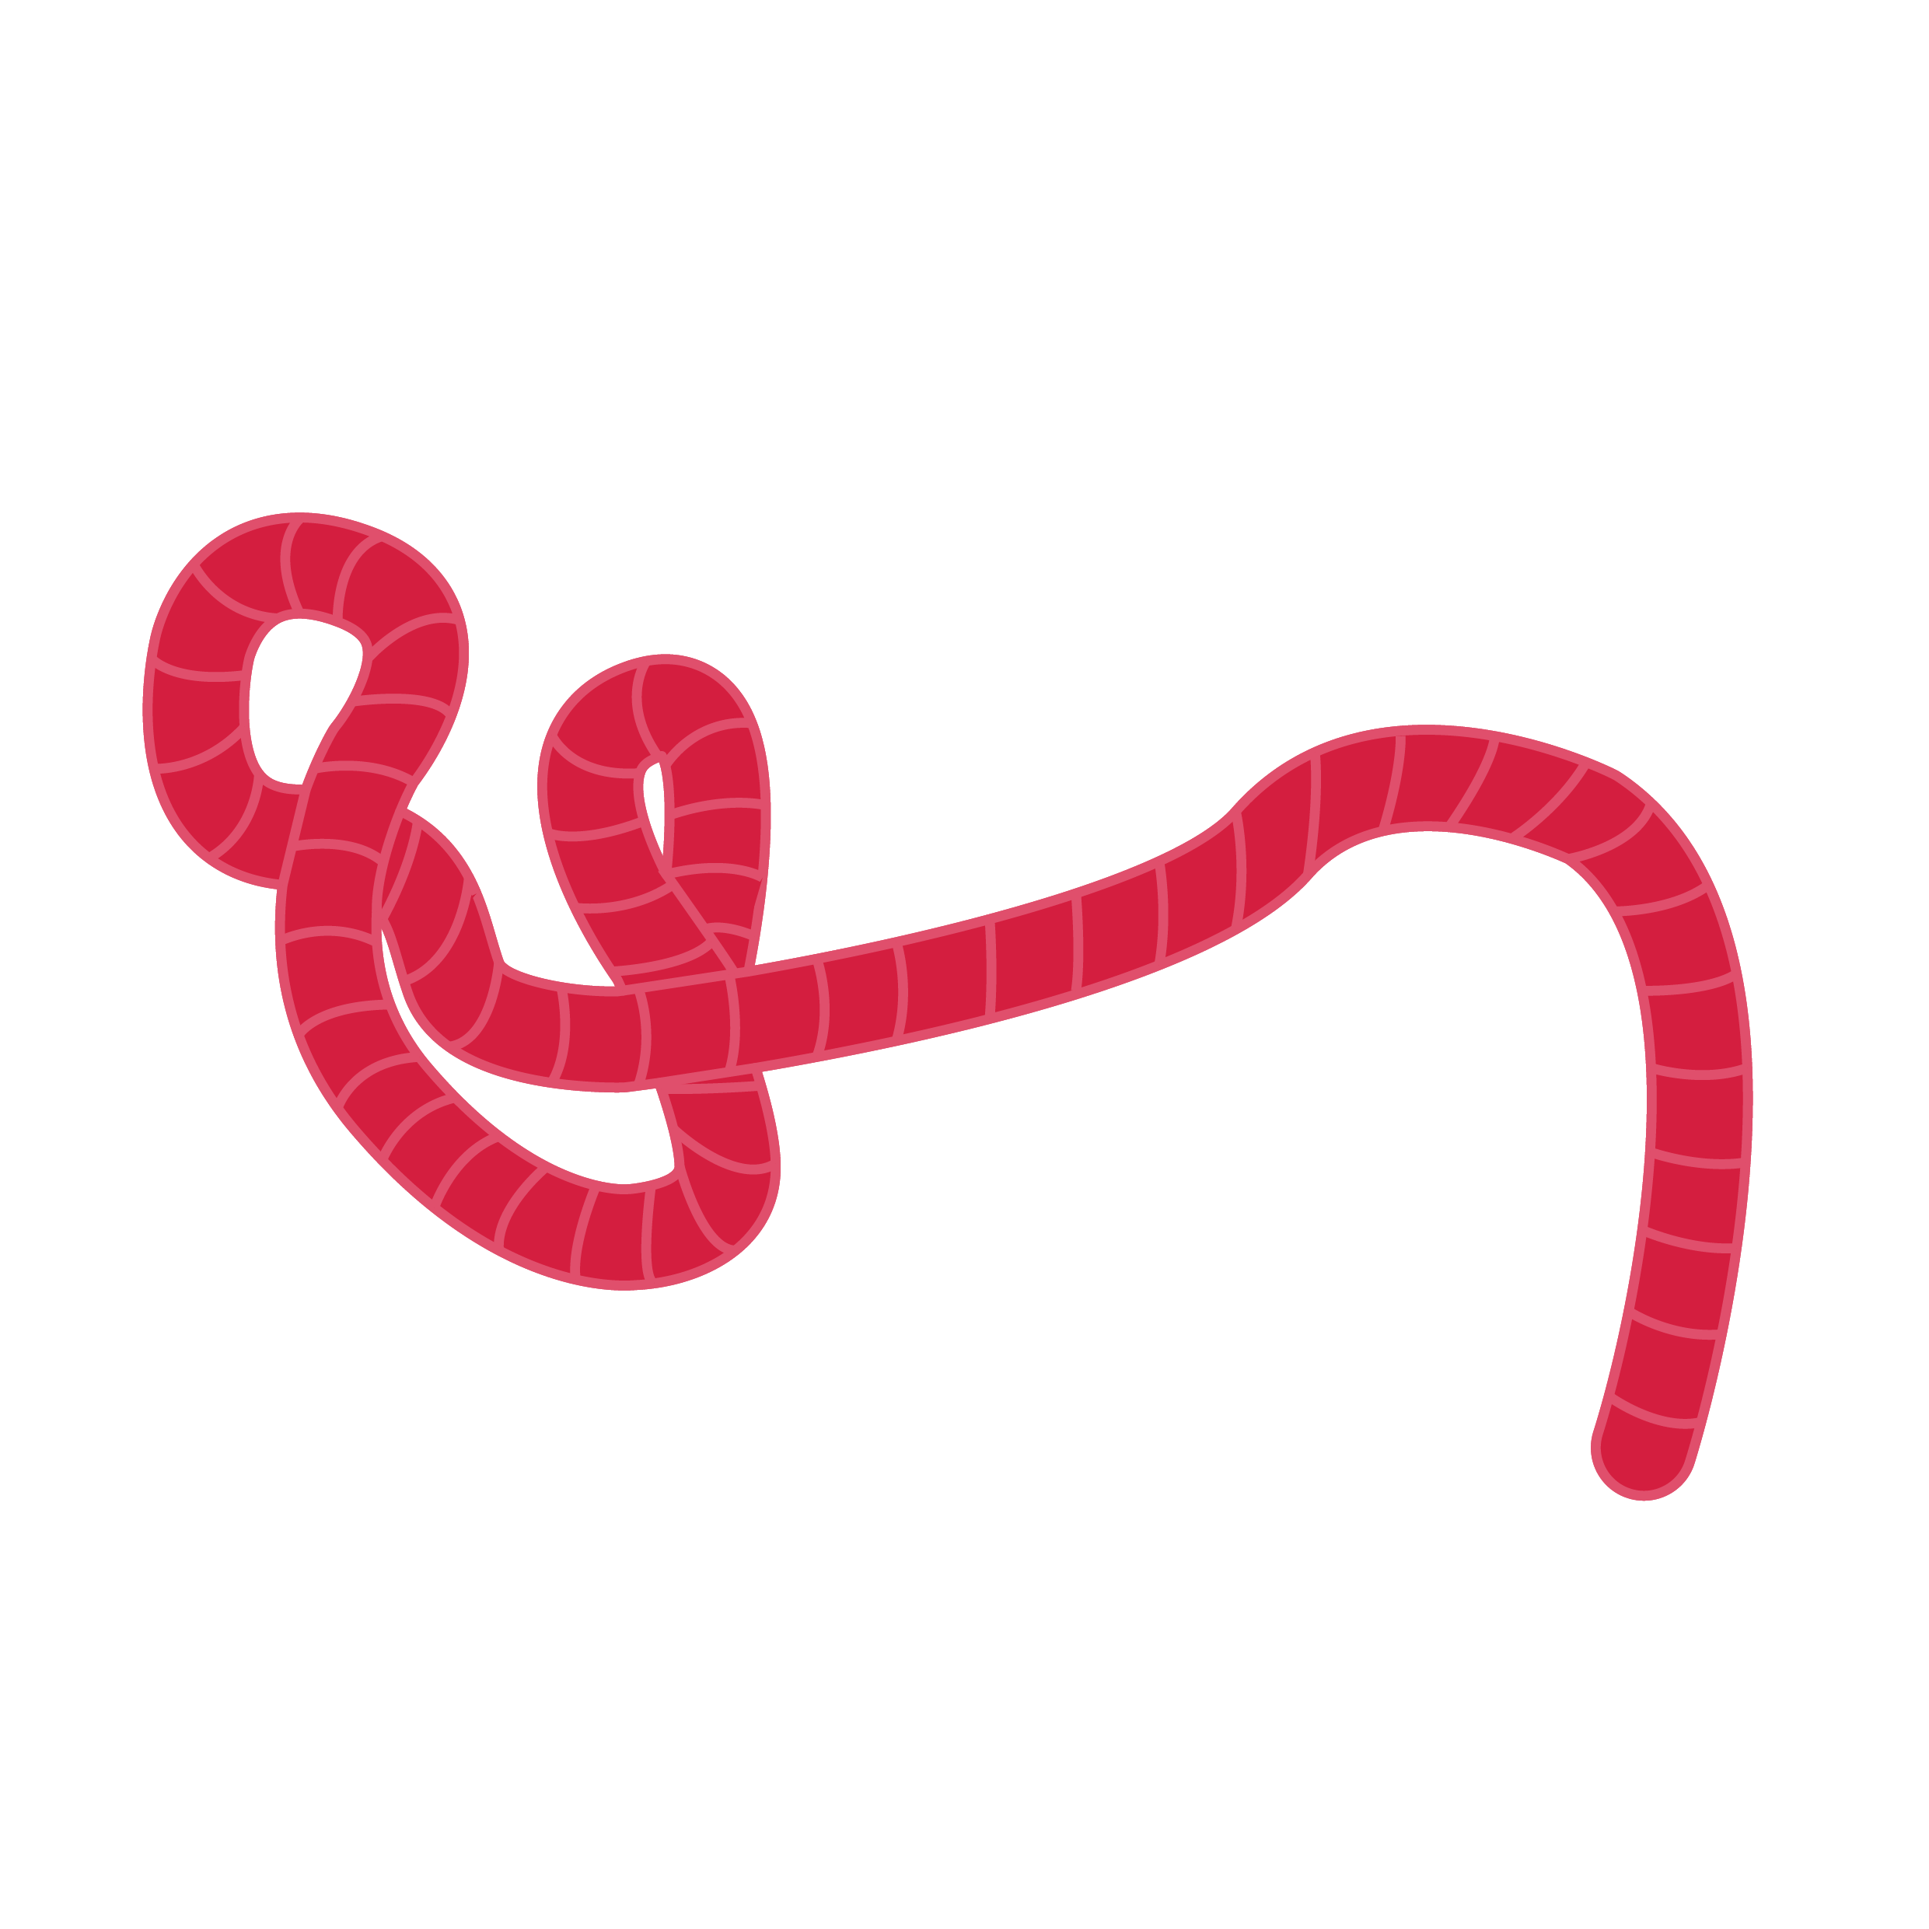
Basic obstetric
Advanced Filovirus Disease Clinical Management

Slide 2
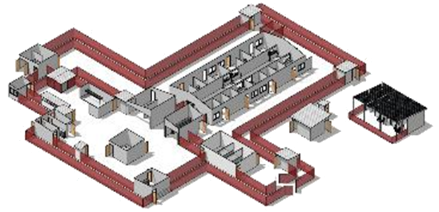
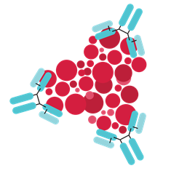
Life-saving management strategy for FVD patients: three key interventions
Design and biosecurity of Treatment Centre
Optimized supportive care
Specific therapeutics
(depends on the causative virus)
Not just an isolation unit
A facility focused on patients, staff, families and communities
A facility where patients can get quality care, compliant with all biosecurity standards and IPC is available
Systematic assessment and monitoring of patients
Resuscitation with oral and IV fluids
Availability of point-of-care tests (biochemistry, electrolytes, haemoglobin, glucometer, malaria RDT, ) and use of oxygen and blood products
Prevention and care of complications
Recommendation for the treatment of EBOV (Zaire ebolavirus):
Ansuvimab (mAb114, Ebanga)
Atoltivimab, maftivimab, odesivimab “cocktail” (REGN-EB3, INMAZEB)
No current specific therapeutic recommendations for other Ebolaviruses and Marburgviruses

Slide 3

Objectives
At the end of this session, you will be able to:
Know how to prepare a Treatment Centre to provide care for pregnant women
Identify supplies needed for obstetric care in the context of FVD
Establish a system of infection prevention to mitigate transmission during obstetric procedures in the context of FVD

Slide 4
Presentation outline
Preparing the Treatment Centre
Care of a pregnant woman
Labour and Childbirth and FVD
Abortion/Miscarriage in FVD
Breastfeeding and FVD
Care of pregnant and recently pregnant FVD survivors

Slide 5
Presentation outline
Preparing the Treatment Centre
Care of a pregnant woman
Labor and Childbirth and FVD
Abortion/Miscarriage in FVD
Breastfeeding and FVD
Care of pregnant and recently pregnant FVD survivors

Slide 6
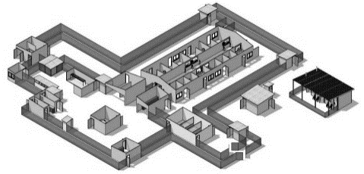



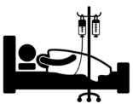



Structure
Supplies
Staff
Security
System
Specific areas for midwifery, obstetrics, newborn and intensive care
Resuscitation equipment (ABCD) – adult and neonatal.
Experienced staff in midwifery, obstetrics, newborn and intensive care.
Apply standard precautions and FVD-specific Infection Prevention Control (IPC) measures for management of pregnant women and their babies.
Rapid screening mechanism for pregnant women and admission.
Rooms adapted and equipped for neonatal resuscitation and newborn care
Obstetric kits (e.g. normal, assisted vaginal birth, caesarean, management of complications including abortion, postpartum haemorrhage)
Systematic initial triage and clinical assessment.
Ensure doctors and nurses are trained on FVD optimized supportive care, obstetric care, neonatal care.
"Nursery" integrated into the Treatment Centre

Slide 7
Presentation outline
Preparing the Treatment Centre
Care of a pregnant woman
Labour and Childbirth and FVD
Abortion/Miscarriage in FVD
Breastfeeding and FVD
Care of pregnant and recently pregnant FVD survivors

Slide 8

Pregnancy and FVD
Pregnant women are not at higher risk of acquiring disease but historical reports suggest there is increased morbidity and mortality among pregnant women and an extremely high rate of adverse pregnancy outcomes
Fetal loss, including miscarriage or stillbirths
Intrauterine fetal death
Pregnancy-associated haemorrhage
Premature rupture of membranes and premature birth
FVD Potential complications

Slide 9

Management of pregnant women
Quick screening (Case definition) + assess pregnancy status of all women of child-bearing age
Triage using standardized tool. Recognize emergency signs and initiate management
Obtain consultation with skilled staff to support the clinical assessment, include fetal status and make care plans
Treat obstetric emergencies. Give optimized supportive care
Specific treatment, once FVD is confirmed
Quickly organize admission as an emergency case.
Screen, triage, clinical assessment and care
Danger signs (May be present but not all)
Heavy bleeding
Convulsion and altered mental status
Severe abdominal pain
Severe headache
SBP ≥ 160 mmHg and DBP ≥ 110 mmHg
Active labour

Slide 10
Childbirth and FVD
Mode of birth (vaginal or cesarean): determined by maternal survival and obstetrical indications and available expertise:
Labour should not be induced for fetal indications in pregnant women with FVD.
Obstetric procedures (such as caesarean section, vacuum extraction, artificial rupture of membranes, episiotomy):
should not be performed for fetal indication given the risk of infection from pregnancy-related fluids and tissues
The least invasive option should be preferred.

Slide 11
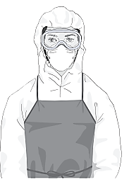
Labour and Childbirth and FVD
REMEMBER (IPC)
Appropriate PPE
There should be at least 2 HCW, preferably 3, at delivery (one of which manages biosecurity)
Pregnant women with FVD
Pregnant women who recover from FVD with viable child
Pregnant contacts of FVD cases
Comprehensive IPC precautions
Full personal proptective equipement (including head cover, face mask, goggles or face shield, boots, coverall or gown, apron, and double gloving with outer glove - elbow length); rigorous and repeated hand hygiene; appropriate waste, sharps and laundry management; and environmental cleaning and decontamination.
Special attention should be given to sharps disposal and decontamination of reusable instruments
If accidental exposure to bodily fluids occurs while providing care to pregnant women or newborns, the exposure should be thoroughly investigated by trained staff and followed as an FVD contact
Adapted from EVD and pregancy

Slide 12
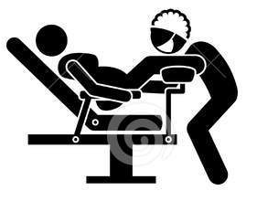

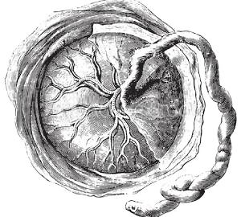

Labour and Childbirth in FVD
If intravenous access can be obtained safely, it should be secured as early as possible.
Spontaneous vaginal delivery should be anticipated.
Vaginal examinations should be minimized, and artificial rupture of membranes avoided.
Avoid standing directly in front of a patient during delivery of foetus or placenta to avoid unnecessary exposure to body fluids
Placenta and any pregnancy related tissue or fluids must be disposed of following FVD-specific IPC protocol for potentially infectious material
If there is a stillbirth/the foetus is not born alive, the cord does not need to be clamped or cut.
See guidance on safe and dignified burials.
https://apps.who.int/iris/rest/bitstreams/611416/retrieve
12

Slide 13
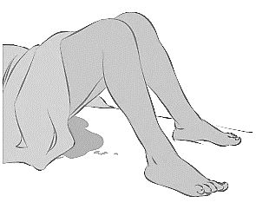
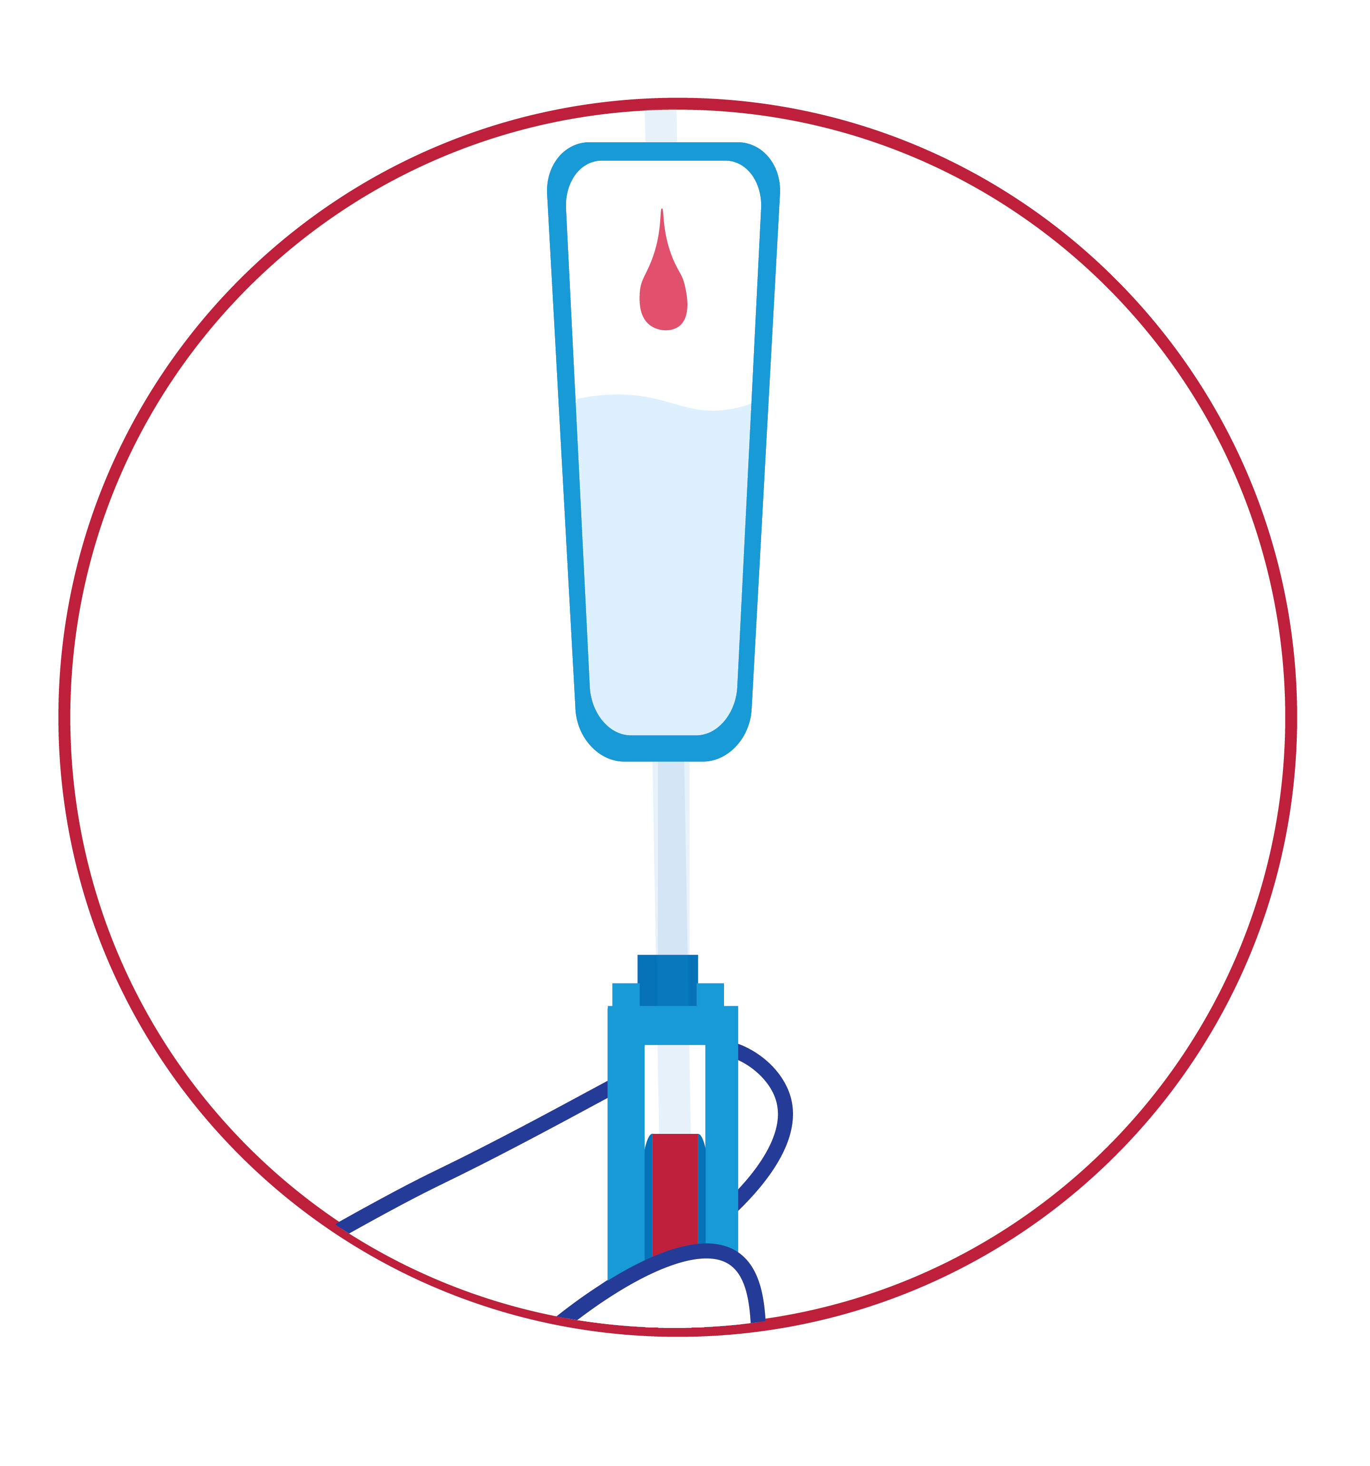
Labour and Childbirth in FVD
Surgical procedures during acute FVD need careful individual considerations from health care workers and patients’ perspective alike
Surgery may be performed by a person with clinical expertise and the ability to operate given the physical restrictions of full PPE
Credit: ALIMA
Use an uterotonic for the prevention of postpartum haemorrhage, as per WHO recommendations
Give the specific FVD treatment as soon as possible if available (pregnant or breastfeeding women and neonate <7days old born to FVD confirmed mothers included)
Oxytocin is the preferred drug for prevention.
In settings where multiple uterotonic options are available, oxytocin (10 IU, IM/IV) is the recommended uterotonic agent for the prevention of PPH for all births
13

Slide 14

Abortion/Miscarriage in FVD
For abortion care and to minimize exposure, abortion by medication (rather than surgical methods) is preferred
Pre abortion
Antibiotic prophylaxis for surgical and medical abortion
Lack of antibiotics should not limit access to abortion services
Missed abortion
Missed abortion at < 14 weeks, for individuals preferring medical management: Recommend the use of combination mifepristone plus misoprostol over misoprostol alone.
Intrauterine fetal demise ≥ 14 to ≤ 28 weeks, the use of combination mifepristone plus misoprostol over misoprostol alone.
Post abortion:
Incomplete abortion: either vacuum aspiration or medical management
Management of non-life-threatening infection and hemorrhage.
Source: Abortion care guideline. Geneva: World Health Organization; 2022
file:///C:/Users/User/Downloads/9789240039483-eng.pdf
14

Slide 15
Presentation outline
Preparing the Treatment Centre
Care of a pregnant woman
Labour and Childbirth and FVD
Abortion/Miscarriage in FVD
Breastfeeding and FVD
Care of pregnant and recently pregnant FVD survivors

Slide 16
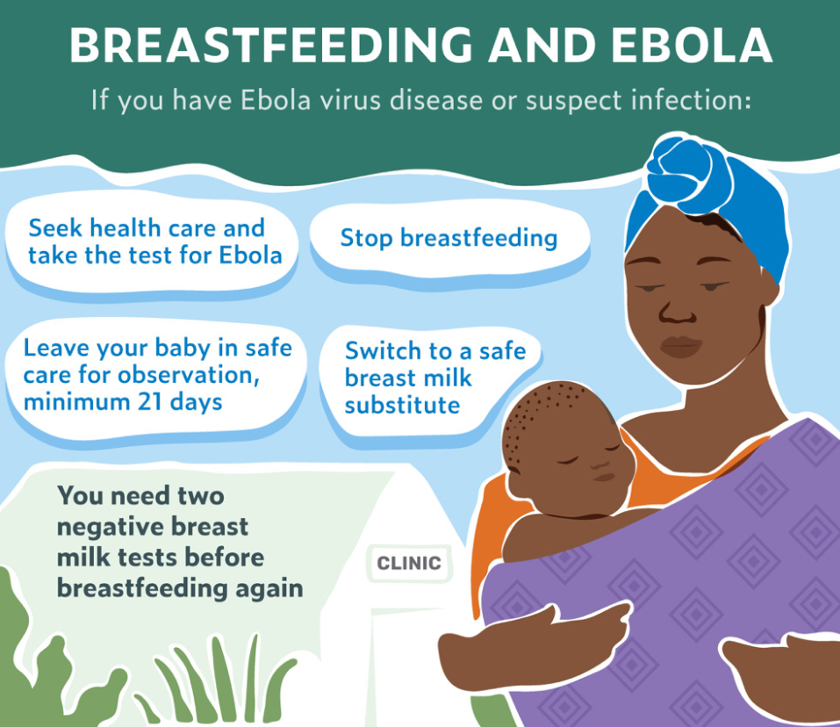
Breasfeeding and FVD
Breastfeeding can only begin once FVD virus elimination in breast milk has been confirmed through two RT-PCR test, 24 hours apart.
Provide infant appropriate Breast Milk Substitute (BMS) until tests results are returned
1st choice: Ready-to-use infant formula (RUIF)
2nd choice: Powdered infant formula (PIF), if RUIF is not available.
No other food/drink should be provided except oral fluids prescribed by the clinician..
If PCR negative, breastfeeding can be resumed.
If PCR positive, options must be discussed with mother.
Provide BMS support until infant is 6 months old when complementary feeding can start.

Slide 17
Decision tree for infant feeding options - mother-child pairs in Treatment Centre
Breasfeeding and FVD
Mother and child suspected of FVD
(awaiting the confirmation)
Separate while awaiting results
Mother: If lacting, suspendd breasfeeding, express and discard
Infant: Provide with breasmilk substitutes
Mother and child are both FVD positive
Case-by-case decision (both admitted to Treatment centre)
If no adequate alternative caregiver, or no safe and appropriate BMS available, consider not separating
Decision to separate
Mother: If lactating, suspend (express and discard) or stop
Infant: Provide with BMS
Mother is FVD positive Infant is FVD negative
Separate (child not admitted to Treatment Centre)
Infant: Provide BMS as an outpatient (+ followed as a contact)
Mother: If lactating, suspend (express and discard) or stop
Mother is FVD negative Infant is FVD positive
Separate (mother not admitted to Treatment Centre)
Mother: If lactating, express breatmilk if able and willing (+ followed as a contact)
Infant: Give expressed breastmilk if available or provide BMS
Mother and infant: if breasfeeding, consider continuing or use BMS
BMS = breastmilk substitute
Notes:
New slide suggestion

Slide 18
Presentation outline
Preparing the Treatment Centre
Care of a pregnant woman
Labour and Childbirth and FVD
Abortion/Miscarriage in FVD
Breastfeeding and FVD
Care of pregnant and recently pregnant FVD survivors

Slide 19
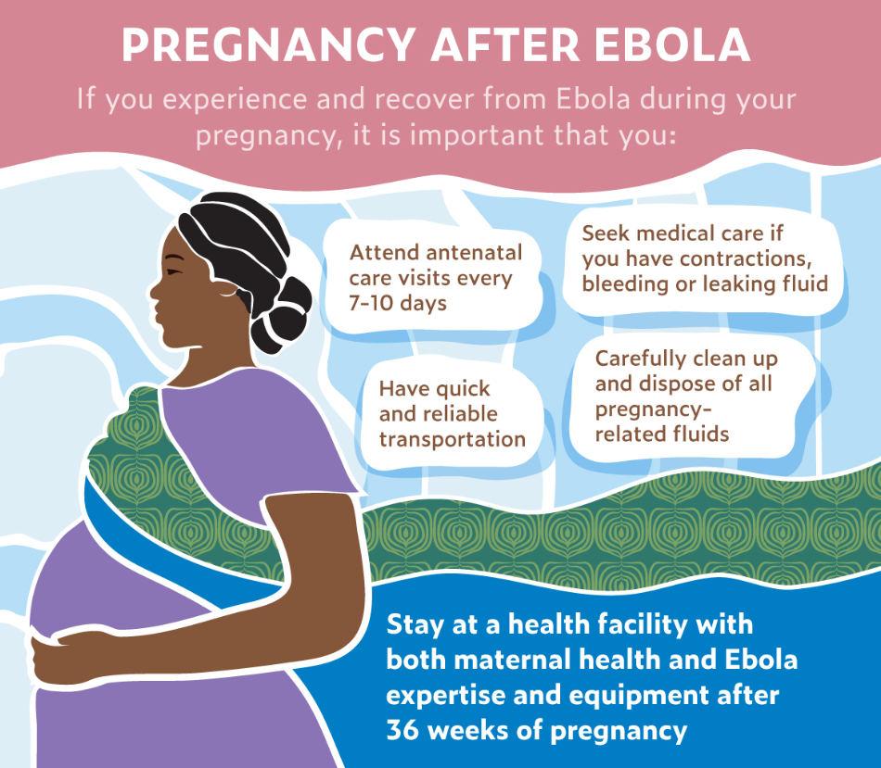
Care of pregnant FVD survivors
Care for pregnant women recovered from FVD with a viable fetus:
If a pregnant woman recovers from FVD:
A childbirth plan must be drawn up at the time of discharge
The virus may still be present in uterus as well as other bodly fluids.
Planning of antenatal consultations
The first follow-up visit should occur within 3 days of Treatment centre’s discharge.
Continued visits every 7–10 days
Select the Treatment Centre site for childbirth, with sufficient IPC measures in place
Source: Guidelines for the management of pregnant and breastfeeding women in the context of Ebola virus disease, World Health Organization, 2020

Slide 20
Care of pregnant FVD survivors
In the situation a pregnant woman has recovered from FVD with a viable fetus:
The FVD virus may still be present in breast milk – even after it is eliminated in the mother's blood
A woman who has recovered from FVD, cleared viremia and wants to continue breastfeeding should wait until after two consecutive negative breastmilk tests by RT-PCR, separated by 24 hours.
During this time, the child should be given a breastmilk substitute.
Perform RT-PCR on:
Birthing fluids (amniotic fluid placenta cord); and,
Possible saliva from the newborn
Source: Guidelines for the management of pregnant and breastfeeding women in the context of Ebola virus disease, World Health Organization, 2020

Slide 21
Questions?

