Slide 1

Advanced Filovirus Disease
Clinical Management
Electrolyte Disorders

Slide 2
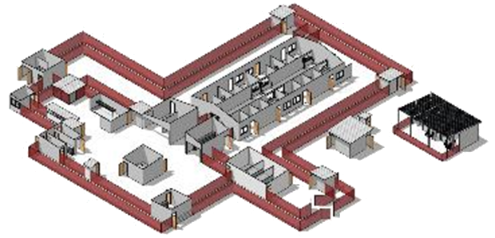
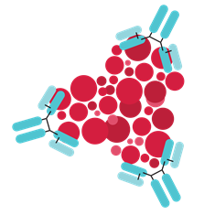
Life-saving management strategy for FVD patients: three key interventions
Design and biosecurity of Treatment Centre
Optimized supportive care
Specific therapeutics
(depends on the causative virus)
Not just an isolation unit
A facility focused on patients, staff, families and communities
A facility where patients can get quality care, compliant with all biosecurity standards and IPC is available
Systematic assessment and monitoring of patients
Resuscitation with oral and IV fluids
Availability of point-of-care tests (biochemistry, electrolytes, haemoglobin, glucometer, malaria RDT, ) and use of oxygen and blood products
Prevention and care of complications
Recommendation for the treatment of EBOV (Zaire ebolavirus):
  Ansuvimab (mAb114, Ebanga)
  Atoltivimab, maftivimab, odesivimab “cocktail” (REGN-EB3, INMAZEB)
No current specific therapeutic recommendations for other Ebolaviruses and Marburgviruses

Slide 3
Objectives
At the end of this session you will be able to:
Describe the importance of early detection of electrolytic abnormalities
Provide measures for the prevention and management of major FVD-related electrolyte abnormalities

Slide 4
Presentation outline
Recognizing electrolyte abnormalities
  Screening
  Clinical manifestations
  Diagnostics (point of care)
Prevention of disorders
  Daily needs
  Prevention
Management

Slide 5
Presentation outline
Recognizing electrolyte disorders
  Screening
  Clinical manifestations
  Diagnostics (point of care)
Prevention of disorders
  Daily needs
  Prevention
Management

Slide 6
Ebola evolution – electrolyte disorders
Early phase
Peak phase
Recovery phase
↓ WBC, ↓ Plt
↑ WBC, (↑ PN), ↓ Hb, ↓ Hct
↑ Plt
Liver failure: ↑ ALT, ↑ AST
Hypoglycaemia
Kidney failure: ↑ BUN, ↑ Creatinine
Electrolyte disorders: ↓ Na+, ↓ or ↑ K+, ↓ Ca++, ↓ Mg++
Metabolic acidosis: ↑ lactate, ↓ HCO-
↑ CPK, myoglobinuria
What is the impact of electrolyte abnormalities in FVD patients?
They can occur at any time
Hypoalbuminaemia
Coagulopathy: ↑ PT, ↑ PTT, ↑ D-dimer
DAY 0
D7
D14
D21
D28
Source: Jacob ST, Crozier I, Fischer WA et al. Ebola virus disease.
Nat Rev Dis Primers. 2020;6(13). https://doi.org/10.1038/s41572-020-0147-3.

Slide 7
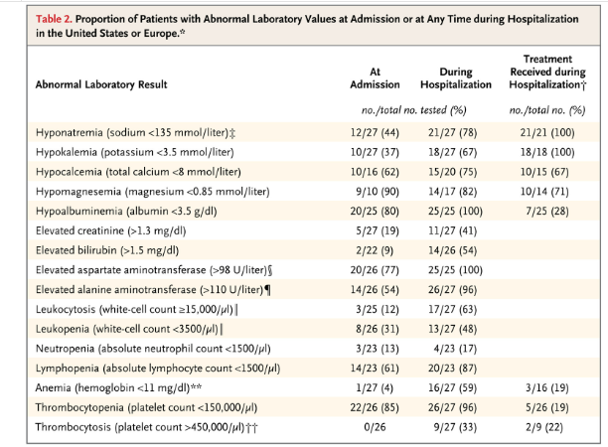
Recognizing electrolyte abnormalities
Electrolyte abnormalities are
common in FVD
The most frequent are:
Hyponatraemia
Hypokalaemia
Hypocalcaemia
Hypomagnesaemia
Hypoalbuminaemia affects calcium concentration
Source: Uyeki TM, Mehta AK, Davey RT et al. Clinical management of Ebola virus disease in the United States and Europe. NEJM. 2016;374:636-646..

Slide 8
Recognizing electrolyte abnormalities
Screening
Routine biochemical assessment for any patient admitted
Clinical manifestations suggestive of a patient with potential electrolyte abnormalities
  Dehydration, diarrhoea, vomiting
  Acute renal failure
  Diuresis
    Diuretics
    Post-ATN diuresis
  Sepsis
  Septic Shock
  Use of hypotonic fluids
  Myositis or rhabdomyolysis
  Transfusion

Slide 9
Recognizing electrolyte abnormalities
Common clinical manifestations of electrolyte abnormalities
Common signs of all disorders
Asthenia and generalized weakness,
Restlessness
Nausea
Vomiting
Acidosis
Altered neurological status
Fasciculations
Myalgia/muscle weakness
Arythmia
HyperK+
HypoNa+
HypoCa++
HyperNa+
HypoK+
HypoMg+

Slide 10
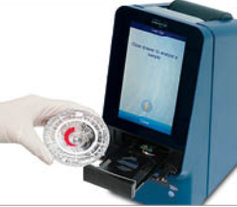
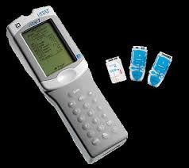
Recognizing electrolyte abnormalities
Lab Values (Diagnostics) - can be performed at the bedside:
Piccolo analyte
i-STAT CHEM8
i-STAT: CG8
Results are available in a few minutes
  Facilitates treatment and follow-up
Caution – haemolysis during sample collection can affect results
  Example – misdiagnosis of hyperkalaemia or hypokalaemia
ECG: not a sensitive tool for detecting electrolyte disorders. Most important for monitoring.

Slide 11
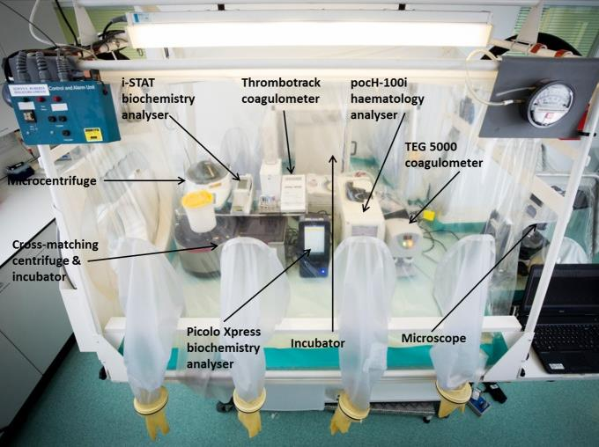
Recognizing electrolyte disorders
Laboratory and point of care devices
I-STAT

Slide 12
Recognizing electrolyte abnormalities
 | Common units | SI units
Alanine aminotransferase (ALT) | 10–47 U/L | 10–47 U/L
Albumin (ALB) | 3.3–5.5 g/dL | 33–55 g/L
Amylase (AMY) | 14–97 U/L | 14–97 U/L
Aspartate aminotransferase (AST) | 11–38 U/L | 11–38 U/L
Calcium (Ca) | 80–103 mg/L | 2.00–2.58 mmol/L
C-reactive protein | 7.5 mg/L | < 7.5 mg/L
Creatine kinase (female) | 30–190 U/L | 30–190 U/L
Creatine kinase (male) | 39–380 U/L | 39–380 U/L
Creatinine | 6–12 mg/L | 53–106 umol/L
Glucose | 730–1180 mg/L | 4.1–6.6 mmol/L
Potassium | 3.6–5.1 mmol/L | 3.6–5.1 mmol/L
Sodium | 128–145 mmol/L | 128–145 mmol/L
Total bilirubin (TBIL) | 2–16 mg/L | 3.4–27.4 umol/L
Blood urea nitrogen (BUN) | 70–220 mg/L | 2.5–7.9 mmol/L
Example of reference values
for Piccolo analyte

Slide 13
Presentation outline
Recognizing electrolyte abnormalities
  clinical manifestations
  diagnostics(POC)
Prevention of disorders
  daily needs
  Prevention
Management

Slide 14
Prevention
Electrolyte requirements per day – an estimate
Electrolytes | Daily requirements in mmol/kg/day |  | Losses
Sodium, Na+ | 2–4 |  | Diarrhoea
Potassium, K+ | 1–2 |  | Vomiting
Calcium, Ca++ | 1 |  | Sweating
Magnesium, Mg++ | 1 |  | Surgical drains
Chloride, Cl- | 3–5 |  | Others
Phosphate, PO4- | 2–3
+

Slide 15
Prevention
Preventive measures
Start taking liquids as soon as possible:
  Orally as tolerated
  Use ORS for all patients: for rehydration or prevention of dehydration in case of diarrhoea
 | Na+ mmol/L | K+ mmol/L | Cl- mmol/L | Bicarbonate mmol/L | Glucose g/L | Mg++ mmol/L
WHO ORS | 90 | 20 | 80 | 30 | 111 | --
  Introduction of enteral feeding
    Proactive
    Caution: gradually increase the volume
    Flow of maintenance fluids will be reduced at the same time
    Total volume of maintenance fluids remains constant
Notes:
Maintenance fluids, replacement fluids and enteral nutrition will be discussed in greater detail in the working groups.

Slide 16
Presentation outline
Recognizing electrolyte disorders
  Detection context
  Clinical manifestations
  Diagnostics(POC)
Prevention of disorders
  Daily needs
  Prevention
Management

Slide 17
Electrolyte abnormalities: pragmatic management
Consider correcting electrolyte abnormalities by IV/IO only if:
Staff have been trained and are available
Lab equipment and patient bedside monitoring available

Slide 18







Management
A. Hypokalaemia (K+ ˂3.5 mmol/L)
Pay attention when correcting: HypoK+ is associated with arrhythmias
Adult
60-80 mmol K+
40 mmol K+
Oral potassium:
When it is can be orally tolerated (absence of vomiting).
Potassium (mmo/L)
3.3-3.5
2.5-2.9
2.5-3.2
< 2.5
0.5-1 mmol/Kg (May be repeated every 6-12 hours)
Associate K+ IV
Child
IV potassium
Maximum concentration for peripheral IV route 10 mmol/L
Never administer IV K+ bolus (always dilute in 0.9% NaCL)
Peripheral or central IV route: 0.5 mmol/Kg/h for 2 hours + 2 mmol/kg PO
Child
Preferred administration via syringe pump or infusion pump
10 ml (1 KCL ampoule) = 1 gr = 13.4 mmol K+
Peripheral IV route 10 mmol/h for 4 hours
Check serum potassium
Additional dose 2-4 hours if needed
In adults any decrease of 0.1 mmol requires replacement with 10 mmol of KCL
Adult
Central IV route: can be increased to 20-40 mmol/hour

Slide 19
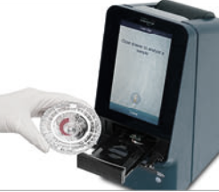


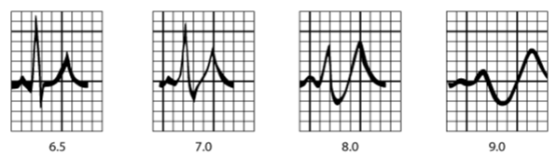


Management
Disorder-specific management
B. Hyperkalemia (K+ >5.5 mmol/L)
1
K+ 5.5 – 6.4 mmol/L
Could this be false hyperkalemia?
EDTA contamination
Sample haemolysis
Sampling from the infusion site
Hyperleukocytosis
Repeat the K+ measurement and
Monitor ECG
Stop fluids, infusions, oral medications containing K+
Managing metabolic acidosis
(Every 0.1 drop in pH, K+ increases by 0.2 to 0.4 mmol/L)
ECG traces in hyperkalemia (serum potassium is in mEq/L and mmol/L)
Notes:
Metabolic Acidosis: For every 0.1 fall in pH K+ increases by 0.2-0.4 mmol/L

Slide 20
Management
If hypovolaemia: liquid bolus (ensure euvolaemia and establish good urine output)
1 B
K+ 5.5 – 6.4 mmol/L
with ECG changes
Only if hypervolaemia: consider furosemide
2
K+ > 6.5 mmol/L or ECG changes
Several treatment options.
Dialysis in case of refractory hyperkalemia, if available.
10 units Humulin R insulin
+
2 ampoules D50%
10mL over 10 minutes
5 to 10ml IV over 10 min
50 mEq, slowly over 2 min
Adult
Calcium gluconate 10%
Calcium chloride 10%
IV insulin and dextrose
Bicarbonate
Child
0.05 units/kg (max 10 units) +
1 ml/kg D50% or 5 ml/kg D10% or 2 ml/kg D25%.
1 mmol/kg IV over 10-15 minutes
0.11 mmol/kg (= 0.5 ml/kg) IV, slowly - 5 min (Max 20 ml)
Repeat K+ measurement after each replacement dose of K+

Slide 21
Management
C. Hypomagnesaemia (Mg+ ˂ 0.85 mmol/L)
Consider magnesium deficiency in the correction of hypokalemia
(Concurrent Mg deficiency in 40% of hypokalaemic patients)
In case of concurrent Mg+ and K+ deficiency,
Correct hypomagnesemia first
Adult
2g by slow IV over 1 hour
Administer Mg Sulfate
0.2 mmol/Kg (max dose 10 mmol) over 1 hour
Child

Slide 22




Management
D. Hypocalcaemia
Calcium correcting formula based on albumin level
Corrected calcium (mg/dL) = serum calcium (mg/dL) + [0.8 x (4 g/dL (normal alb.) - measured alb. (g/dL)]
In mmol/l = for each 1g/dl of albumin below normal, increase serum calcium by 0.2 mmol/l
(or 0.02 mmol/l if calculation of Albumin in g/litre)
If corrected calcium < 7.5mg/dL or < 1.9 mmol/l: supplement with calcium
In 40ml of
Adult
1 - 2 g or 2.25 – 4.5 mmol
Repeat dose after 10 to 60 minutes if necessary
10 ml ampoule of Calcium gluconate 10% = 1g (or 2,2 mmol) of calcium
D5%
OR
NaCl
0,9%
0.11 mmol/kg = 0.5 ml/kg
Child
Infuse over 10 - 20 min
Notes:
Calcaemia must be interpreted according to albumin because 50% of calcium is bound to albumin and only free ionized calcium is active

Slide 23
Management
E. Hyponatraemia (Na+ < 135 mmol/L)
Do not correct sodium rapidly (risk of central pontine myelinolysis)
ABCD + supplemental O2
Treat underlying causes (e.g. malaria/sepsis)
IV fluid adjustment + fluid balance
  Isotonic solutions for IV fluid resuscitation (NaCl 0.9%)
  ORS for oral rehydration
The maximum correction rate is 9 mmol/L in 24 hours
Hypovolemic
Fluid resuscitation
Crystalloid solutions | Na mmol/L | K mmol/L | Cl mmol/L
Ringer lactate | 131 | 4 | 109
Saline solution 0.9% | 154 | 0 | 154
Determine etiology
based on volume status
Euvolemic
Avoid free water
Hypervolemic
Consider diuretics
Rechecking blood sodium if any clinical change and after a therapeutic intervention

Slide 24

Management
F. Hypernatraemia (Na+ > 145 mmol/L)
In EVD: hypernatraemia is most often due to fluid loss (dehydration) as a result of diarrhoea/vomiting
Correct existing fluid deficit
Fluid deficit (L) = [ (current Na+ / target Na+) – 1) ] x 0.6 (body weight in Kg)
i.e. 0.6 x weight x [(Na+/140) - 1]
Acute symptomatic hypernatremia can be lowered from 1 mmol/l/h up to 145 mmol/L
50% for replacement over the first 12 hours and the remaining 50% over 24 - 48 hours
AND
Replace ongoing
fluid losses
If replacement is too fast can expose the patient to the risk of cerebral oedema – especially important in pediatric patients

Slide 25
Summary
Electrolyte abnormalities are common (enteral losses, renal failure) in FVD.
Electrolyte abnormalities may be associated with severe complications (e.g. cardiac arrhythmias).
Preventing electrolyte abnormalities is possible:
  Encourage ORS for oral hydration in all patients as tolerated.
  Appropriate use of IV fluids.
Early detection and treatment of electrolyte abnormalities saves lives.
Hypokalaemia and hyponatraemia are common in FVD patients and can be life-threatening (do not forget magnesium)
Hypocalcaemia should be treated (be careful to account for corrected calcaemia as albumin is often low in patients in critical care settings).

Slide 26
Questions?

