Slide 1

Advanced Filovirus Disease
Clinical Management
Acute
Renal Failure

Slide 2
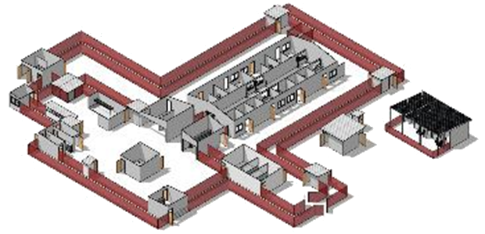
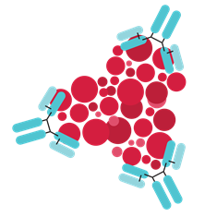
Life-saving management strategy for FVD patients: three key interventions
Design and biosecurity of Treatment Centre
Optimized supportive care
Specific therapeutics
(depends on the causative virus)
Not just an isolation unit
A facility focused on patients, staff, families and communities
A facility where patients can get quality care, compliant with all biosecurity standards and IPC is available
Systematic assessment and monitoring of patients
Resuscitation with oral and IV fluids
Availability of point-of-care tests (biochemistry, electrolytes, haemoglobin, glucometer, malaria RDT, ) and use of oxygen and blood products
Prevention and care of complications
Recommendation for the treatment of EBOV (Zaire ebolavirus):
  Ansuvimab (mAb114, Ebanga)
  Atoltivimab, maftivimab, odesivimab “cocktail” (REGN-EB3, INMAZEB)
No current specific therapeutic recommendations for other Ebolaviruses and Marburgviruses

Slide 3
Presentation outline
Recognizing and preventing acute kidney injury (AKI)
Recognizing acute renal failure (ARF)
Managing ARF and complications

Slide 4
Presentation outline
Recognizing and preventing acute kidney injury (AKI)
Recognizing acute renal failure (ARF)
Managing ARF and complications

Slide 5
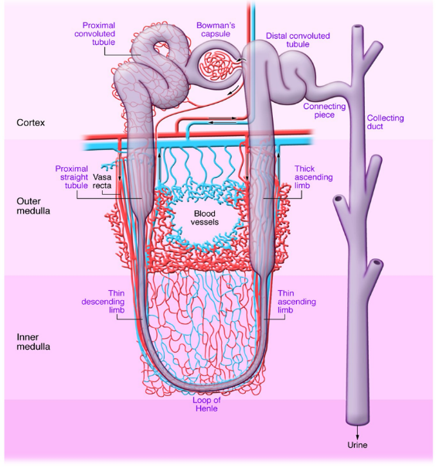
Recognizing and preventing acute kidney injury
Key kidney functions
Regulation and elimination of plasma substances and metabolic products
Electrolyte balance
Plasma volume and osmolarity
Acid-base balance
Elimination of metabolites (for example, urea, uric acid, creatinine)
Disposal of exogenous chemicals (drugs, etc.)
Kidneys receive 20% of cardiac output
Highly sensitive to hypoxic and hypoperfusion impacts

Slide 6
Recognizing and preventing acute kidney injury
Rhabdomyolysis
Pre-existing kidney disease
Co-infections:
malaria, bacterial infections
Filovirus: direct affect on kidney function
Shock (hypoperfusion)
Nephrotoxic drugs
Causes of kidney injury in FVD
Obstruction
Notes:
https://www.srlf.org/wp-content/uploads/2016/03/2015_RFE_Insuffisance_R%C3%A9nale_Aigue_en_p%C3%A9riop%C3%A9ratoire_et_en_R%C3%A9animation.pdf

Slide 7
Recognizing and preventing acute kidney injury
FVD-Related Risk Factors for AKI
Disease-related risk factors:
Demographic/Past medical history risk factors
  Sepsis
  Haemodynamic instability (dehydration, sepsis, septic shock)
  Nephrotoxic substances
Age ≥ 65 years
Pre-existing kidney disease
High blood pressure
Chronic co-morbidity
  Diabetes
  Congestive heart failure
  Liver failure
Obesity (BMI > 40 kg/m²)
Urine output should be monitored in all
critically ill patients:
Normal: >0.5 mL/kg/h (>1mL/kg/h in children)
Do not wait until creatinine is measured before starting preventive measures

Slide 8
Recognizing and preventing acute kidney injury
How to prevent AKI?
Prevent/Correct hypovolaemia (+ transfusion if necessary)
Administer oxygen
Treat infections and other conditions
Continuous care
Regularly assess ABCDE
Monitor fluid balance - inputs and outputs, 24hr daily totals
Calculate maintenance fluids and replace losses
Take weight daily – if possible
Laboratory: electrolytes, creatinine, blood gases
Avoid administration of potentially nephrotoxic drugs
Use urinary catheters or urinary pockets only as long as necessary (good IPC practice)
Fluid resuscitation: use crystalloids, ideally Ringer Lactate, or 0.9% w/v NaCl
Blood pressure targets: MBP 60–70 mmHg
Noradrenaline is preferred if a vasopressor is required to maintain MAP targets
Close monitoring of urine output, electrolytes, and acid/base status

Slide 9
Presentation outline
Recognizing and preventing acute kidney injury (AKI)
Recognizing acute renal failure (ARF)
Managing ARF and complications

Slide 10
Recognizing acute renal failure
ARF is defined as:
Serum creatinine: ≥ 3 mg/L or ≥ 26.5 mmol/L in 48 hours
Urine output
  Adult: < 0.5 mL/kg for 6 hours
  Child: or < 1 mL/kg for 6 hours
What are the severity stages of ARF?
Classification of KDIGO (Kidney Disease Improving Global Outcomes) - 2012
ARF status | Creatinine | Unire output
1 | Increase of > 3 mg/L (26 µmol/L) in 48 h | < 0.5 mL/kg/h for 6 to 12 hours
2 | 2 x creatinine in 7 days | < 0.5 mL/kg/h for more than 12 hours
3 | 3 x creatinine in 7 days or Serum creatinine > 40 mg/L (354 µmol/L) in the absence of prior values or Need to start dialysis | < 0.3 mL/kg/h for more than 24 hours or Anuria ≥ 12 h

Slide 11
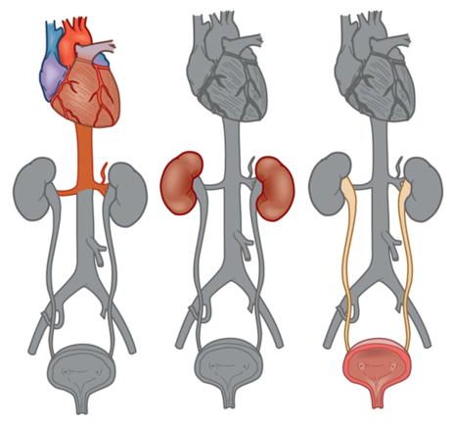
Identifying potential etiologies of acute renal failure
Prerenal
Renal
Postrenal
Classification by mechanism (common causes in FVD)
Pre-renal causes:
Loss of renal perfusion associated with dehydration/sepsis/septic shock
Haemoglobinuria, rhabdomyolysis
Renal causes:
Acute tubular necrosis (ATN) associated with prolonged hypoperfusion
Filoviruses can be the direct cause of an AKI
Drugs and toxins (for example, NSAIDs, aminoglycosides)
Post-renal causes:
Urinary obstruction (renal/ureteral stone, blood clots, tumor)
Source: Elsevier Inc (2017).
Notes:
Quizlet
Acute Kidney Injury & Chronic Kidney Disease Flashcards | Quizlet

Slide 12
Management of ARF
What are the complications of ARF?
Decreased renal function
Associated complications
Elimination of waste products
Accumulation of catabolic products
(urea, uric acid, creatinine, etc.)
Regulation of extra-cellular volume
Fluid overload
Electrolyte balance
Hyperkalaemia
Non-volatile acid accumulation
(no removal by ventilation)
Metabolic acidosis

Slide 13
Presentation outline
Recognizing and preventing acute kidney injury (AKI)
Recognizing acute renal failure (ARF)
Managing ARF and complications

Slide 14
Recognizing acute renal failure
Vital prognostic factors
Initial septic shock
Several associated visceral failures
Occurrence of complications
Site of ARF occurrence
Principles of ARF management
Airway and breathing + O2

Slide 15
Managing acute renal failure
Principles of ARF management
Laboratory monitoring of creatinine and BUN (Blood Urea Nitrogen)
Monitor urine output; consider urinary catheterization to accurately measure urine output
Assess for reversible causes of acute renal failure: treat accordingly
Ensure sufficient intake: maintain renal perfusion with adequate crystalloid fluid resuscitation and vasopressors. Adequate renal perfusion is essential to prevent further kidney damage
Manage complications
Managing complications
Electrolyte disorders (see electrolyte disorders module)
Acidosis
Uremia

Slide 16
Managing acute renal failure
Metabolic acidosis
Cause of metabolic acidosis
in FVD
Acute renal failure
Mechanisms for
developing acidosis
↓ Acid excretion
Arterial/venous blood gas (if available)
Septicaemia, shock
High volume diarrhoea
pH < 7.35
Measure bicarbonate and base excess to confirm acidosis
↑ Acid production
Gastrointestinal or renal renal HCO₃− loss
Acute
symptomatology
Asymptomatic
(moderate acidosis)
Nausea/vomiting
Decreased responsiveness to vasopressors
Hyperpnea
Notes:
https://www.msdmanuals.com/fr/professional/troubles-endocriniens-et-m%C3%A9taboliques/r%C3%A9gulation-et-troubles-acido-basiques/acidose-m%C3%A9tabolique

Slide 17
Managing acute renal failure
Metabolic acidosis (continued)
Cause (measure the anion gap - AG)
Calculated AG: Na - (Cl + HCO3)
Normal anion gap : 2.5 x albumin - 2 ≤ AG ≥ 2.5 x albumin + 2 (Which range is 8 -12)
an AG is present if the calculated AG is > the normal AG
Anion gap and metabolic acidosis | No anion gap and metabolic acidosis
Kidney failure | Diarrhoea
Ketoacidosis (diabetic or alcohol-induced, malnutrition) | Acidosis by dilution (hyperchloremic acidosis – can be seen with 0.9% NS resuscitation)
Toxic substance ingestion (ethylene glycol, INH, methanol, paraldehyde, salicylates) | Renal HCO₃ loss/renal tubular dysfunction
Lactic acidosis (sepsis)

Slide 18
Managing acute renal failure
Metabolic acidosis (continued)
Metabolic acidosis with increased anion gap
Treatment of the underlying condition
Low chloride:
  add 150 mEq of NaHCO₃ to 1 L of G5% or 0.9% saline to obtain an isotonic liquid
  start at 50–100 mL/hour
  with close monitoring of Na+ and HCO₃
ARF-associated metabolic acidosis
Metabolic acidosis with normal anion gap with hyperchloraemia
Ringer’s lactate:
  in prevention: resuscitation solution must be replaced by Ringer's lactate after the first 3 L, if 0.9% saline is used initially
Notes:
Consider underlying therapy for increased BP, LR for normal BP with hyperchloremia, and bicarbonate for AKI metabolic acidosis

Slide 19
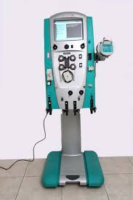
Managing acute renal failure
  Fluid overload
  Loop diuretics, PO or IV, bolus or continuous
    Furosemide IV 1 mg/kg (consider additional and higher doses
    +/- Furosemide infusion)
  Avoid using diuretics to induce diuresis in patients that have a low or no urine output
Renal replacement therapy: complications of ARF refractory to conservative management:
  Symptomatic hyperkalaemia (> 6.5 mmol/L with ECG signs) associated with anuria
  Severe metabolic acidosis (pH < 7.2)
  Volume overload resistant to diuretic therapy
RRT possible in some highly functioning Treatment Centers
Notes:
“Never use a hammer to hammer things”

Slide 20

Managing acute renal failure
Monitoring
Vital signs + NIBP (+/- EKG)
Monitoring of fluid balance, inputs/outputs, 24 hr totals
Monitoring weight daily if possible
Tests at Treatment centre:
  urine strips
  blood glucose level
  malaria RDT
  Hgb
  electrolytes​
  creatinine/urea​
  blood gas + lactate​
  others

Slide 21
Summary
In FVD, as in other forms of "septic syndromes", ARF is an important risk factor for mortality.
Many patients with Ebola or Marburg virus infections have some degree of ARF.
ARF:
  A and B – breathing stabilization
  Correcting pre-renal causes: dehydration, sepsis, shock and severe anaemia treatment
  Fluid balance: adjusting maintenance fluids
  No nephrotoxic drugs, discontinue all potassium-containing solutions
  Treat complications: hyperkalaemia, acidosis, encephalopathy, fluid overload.
In advanced facilities:
  Extrarenal therapy may be appropriate in cases of severe ARF.

Slide 22
Questions?

