Slide 1

Advanced Filovirus Disease Clinical Management
Hypoglycaemia

Slide 2
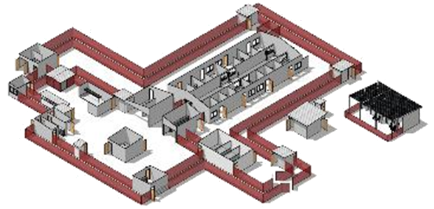
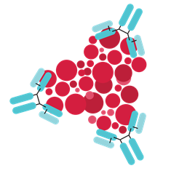
Life-saving management for Filovirus Disease patients: Three key interventions
Design and biosecurity of Treatment Centre
Optimized supportive care
Specific therapeutics
(depends on the causative virus)
A facility centered around patients, staff, families and communities
A facility where patients can get quality care, compliant with all biosecurity standards and IPC
Not just an isolation room
Systematic assessment and monitoring of patients
Resuscitation with oral and IV fluids and vasopressors
Availability of point-of-care tests (biochemistry, haemoglobin, glucometer, malaria RDT) and use of oxygen and blood products
Prevention and management of complications (electrolytes management…)
Recommendation for the treatment of EBOV (Zaire ebolavirus):
Ansuvimab (mAb114, Ebanga)
Atoltivimab, maftivimab, odesivimab “cocktail” (REGN-EB3, INMAZEB)
No current specific therapeutic recommendations for other Ebolaviruses and Marburgviruses

Slide 3
Learning objectives
At the end of this session, you should be able to:
Describe the monitoring for hypoglycaemia in FVD patients
Describe immediate and appropriate management of severe hypoglycaemia in children and adults

Slide 4
Presentation outline
Recognize and prevent hypoglycaemia
Correct hypoglycaemia
Monitoring

Slide 5




Ebola clinical course - hypoglycaemia
Early phase
Peak phase
Recovery phase
↓ WBC, ↓ Plt
↑ WBC, (↑ PN), ↓ Hb, ↓ Hct
↑ Plt
Liver failure: ↑ ALT, ↑ AST
Hypoglycaemia
Kidney failure: ↑ BUN, ↑ Creatinine
Electrolyte disorders: ↓ Na+, ↓ or ↑ K+, ↓ Ca++, ↓ Mg++
Metabolic acidosis: ↑ lactate, ↓ HCO-
↑ CPK, myoglobinuria
What is the impact of hypoglycaemia in FVD patients?
How to detect and manage hypoglycaemia in Treatment Centres?
Hypoalbuminaemia
Coagulopathy: ↑ PT, ↑ PTT, ↑ D-dimer
DAY 0
D7
D14
D21
D28
Source: Jacob ST, Crozier I, Fischer WA et al. Ebola virus disease.
Nat Rev Dis Primers. 2020;6(13). https://doi.org/10.1038/s41572-020-0147-3.

Slide 6
Recognize and prevent hypoglycaemia
Some common symptoms and signs of hypoglycaemia:
Mild hypoglycaemia
Sweating (diaphoresis)
Tremor
Nausea
Extreme hunger
Nervousness
Moderate hypoglycaemia
Difficulty concentrating or speaking
Weakness
Visual changes
Confusion
Altered mental status
Severe hypoglycaemia
Loss of consciousness
Convulsions / seizures
Notes:
Hypoglycaemia may not have overt clinical manifestations. It is advisable not to miss these evocative signs

Slide 7
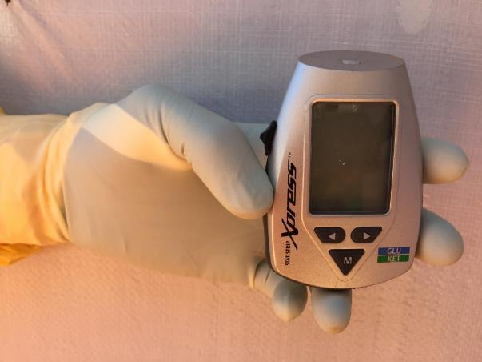
Recognize and prevent hypoglycaemia
Important to not wait for clinical manifestations of hypoglycaemia
If possible, prevent hypoglycaemia
Upon admission; encourage the patient to eat and drink as tolerated
Measure blood glucose in all admitted patients and daily (more frequently if required)
If unable to measure blood glucose, administer empirical glucose therapy
Any hypoglycaemia (< 54 mg/dL or < 3 mmol/L) must be treated urgently
Notes:
Prevent hypoglycaemia in all patients admitted or interned at the ETC. Measure blood glucose daily in all patients if possible. Otherwise, treat before you have complications

Slide 8
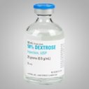
Treatment of hypoglycaemia
How to treat hypoglycaemia emergently:
50% dextrose solution | 25 g of glucose (dextrose) | 50 mL of water
10% dextrose solution | 10 g of glucose (dextrose) | 100 mL of water
5% dextrose solution | 5 g of glucose (dextrose) | 100 mL of water
Notes:
Generally, avoid 5% glucose serum for the correction of severe hypoglycemia: too low glucose concentration and volume of free water can induce hyponatremia

Slide 9

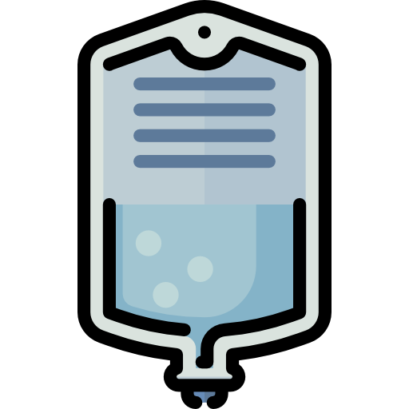

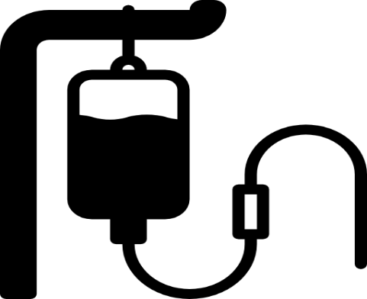
Treatment of hypoglycaemia
How to treat hypoglycaemia:
In patients with hypoglycaemia WITHOUT altered consciousness and WITHOUT seizures:
Encourage eating and drinking to maintain their blood sugar levels
Dextrose 10% at sufficient flow to maintain blood sugar
If a maintenance solution is used, add Dextrose 50%
In case of inability to eat
OR
Dextrose
10%
Dextrose50%
Source: Optimized supportive care for ebola virus disease: clinical management standard operating procedures, WHO, 2019

Slide 10
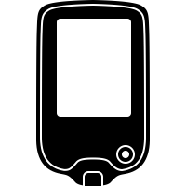



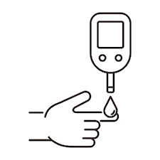
Treatment of hypoglycaemia
How to treat severe hypoglycaemia?
Target blood sugar: >
4.4 mmol/L
80 mg/dL
In pediatric patients, including newborns, with hypoglycaemia AND impaired consciousness OR seizure
Dextrose
10%
Dextrose
10%
Dextrose
10%
Volume: 2.5–5 mL/kg
Slowly: 2–3 mL/min
Maintain glucose infusion 4–6 mg/kg/min or 5 g/kg/day
Check blood sugar after 15 minutes
2mL/kg
If hypoglycaemia persists and increase flow
Source: Optimized supportive care for ebola virus disease: clinical management standard operating procedures, WHO, 2019
Notes:
In children, avoid the SG50%: can cause rebounds of hypoglycaemia. The same for too rapid infusion of SG10%

Slide 11

Treatment of hypoglycaemia
Target blood sugar >
4.4 mmol/L
80 mg/dL
How to treat severe hypoglycaemia in adults ?
In adult patients with hypoglycaemia and impaired consciousness or seizures
RL or NaCl 0.9%
(900 mL)
+
Dextrose
50%
(100 mL)
OR
Dextrose
50%
Dextrose 50%
1 min
Dextrose 10%
Possible 2nd bolus 50 mL (25g) within the next hour
Quantity: 50 mL (25 g) IV
Give slowly over 1 minute
Add continuous glucose infusion;
adjust rate to maintain target blood glucose:
(50 mL/hr of dextrose 10%)
Check blood sugar after 15 minutes
Source: Optimized supportive care for ebola virus disease: clinical management standard operating procedures, WHO, 2019
Notes:
Use 50% glucose serum slowly then maintain with Ringer lactate + 50% SG mixture or only 10% glucose serum. A second bolus is possible within one hour

Slide 12
Monitoring
On admission: all patients
Electrolytes
Serum sodium and potassium must be monitored given the volume of free water provided by dextrose 10%
Blood sugar
Once a day if no hypoglycaemia
Every 8 hours or more frequently:
if symptomatic hypoglycaemia and in neonates
After correction of severe hypoglycaemia
Adjust infusion rate to maintain blood glucose
> 4.4 mmol/L (> 80 mg/dL)
If target reached
recheck after 1 hour
If 4 normal hourly blood glucose levels
recheck every 4 hours
Source: Optimized supportive care for ebola virus disease: clinical management standard operating procedures, WHO, 2019
Notes:
Arrange structured blood glucose monitoring to maintain above 80 mg/dl. Beware of the repercussions on sodium and potassium. Consider a nurse for monitoring and feeding

Slide 13
Early phase
Peak phase
Recovery phase
↓ WBC, ↓ Plt
↑ WBC, (↑ PN), ↓ Hb, ↓ Hct
↑ Plt
Liver failure: ↑ ALT, ↑ AST
Hypoglycaemia
Kidney failure: ↑ BUN, ↑ Creatinine
Electrolyte disorders: ↓ Na+, ↓ or ↑ K+, ↓ Ca++, ↓ Mg++
Metabolic acidosis: ↑ lactate, ↓ HCO-
What is the impact of hypoglycaemia in FVD patients?
How to detect and manage hypoglycaemia in Traitment Center?
↑ CPK, myoglobinuria
Hypoalbuminaemia
Coagulopathy: ↑ PT, ↑ PTT, ↑ D-dimer
DAY 0
D7
D14
D21
D28
Early identification of patients with hypoglycaemia and rapid treatment save lives. Frequent reassessment is essential to prevent complications such as seizures, coma, and death.
Source: Jacob ST, Crozier I, Fischer WA et al. Ebola virus disease.
Nat Rev Dis Primers. 2020;6(13). https://doi.org/10.1038/s41572-020-0147-3.

Slide 14
Questions?

