Slide 1
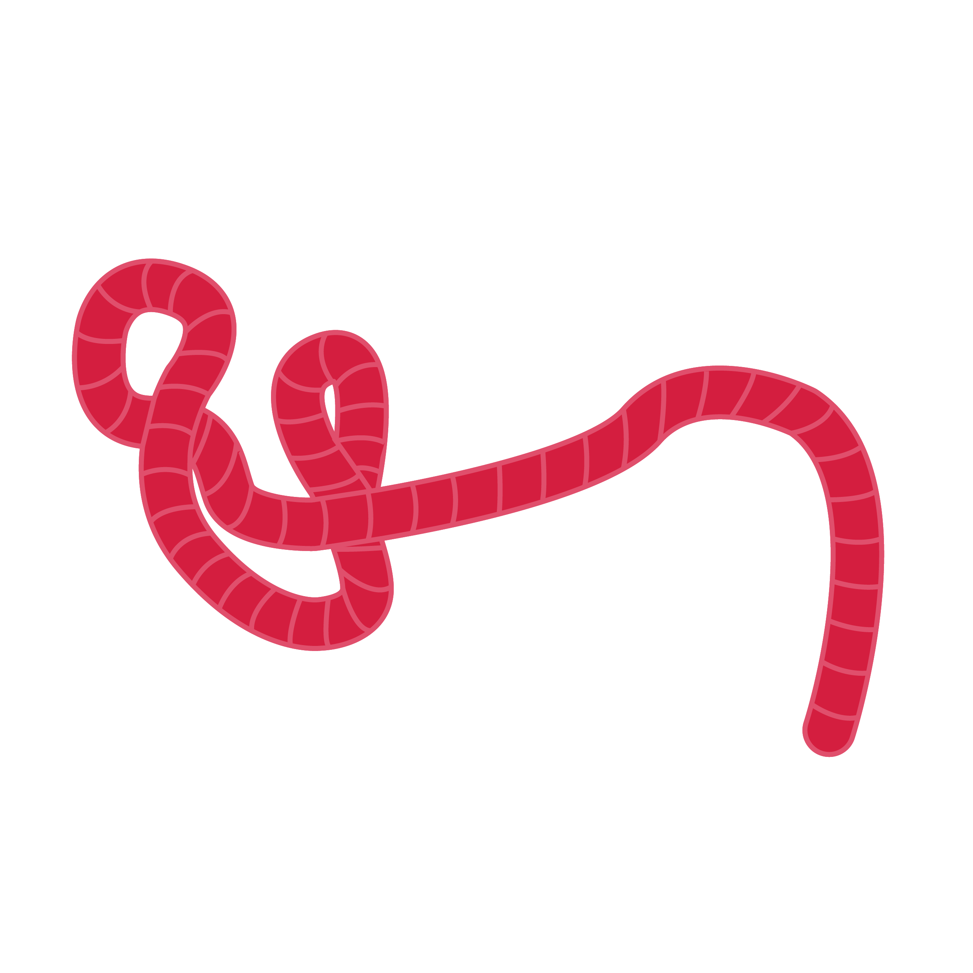
Encephalopathy management
Advanced Filovirus Disease Clinical Management

Slide 2
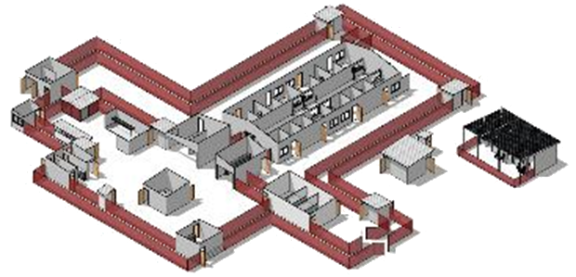
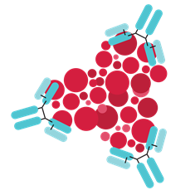
Life-saving management strategy for FVD patients: three key interventions
Design and biosecurity of Treatment Centre
Optimized supportive care
Specific therapeutics
(depends on the causative virus)
Not just an isolation unit
A facility focused on patients, staff, families and communities
A facility where patients can get quality care, compliant with all biosecurity standards and IPC is available
Systematic assessment and monitoring of patients
Resuscitation with oral and IV fluids
Availability of point-of-care tests (biochemistry, electrolytes, haemoglobin, glucometer, malaria RDT, ) and use of oxygen and blood products
Prevention and care of complications
Recommendation for the treatment of EBOV (Zaire ebolavirus):
Ansuvimab (mAb114, Ebanga)
Atoltivimab, maftivimab, odesivimab “cocktail” (REGN-EB3, INMAZEB)
No current specific therapeutic recommendations for other Ebolaviruses and Marburgviruses

Slide 3
Learning objectives
At the end of this presentation, you should be able to:
Describe how to assess patients for neurologic impairment
Identify key signs/symptoms suggestive of neurological impairment at triage
Understand the vital process of addressing high-risk parameters of neurological impairment
Describe how to manage a patient with encephalopathy

Slide 4
Presentation outline
Recognizing the signs of neurological impairment
Management of seizures
Altered state of consciousness and encephalopathy

Slide 5
Recognizing signs of neurological impairment

Slide 6
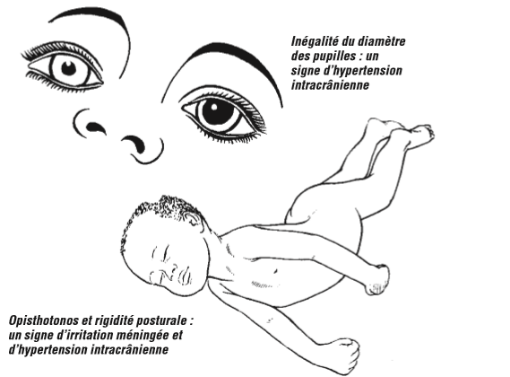
Recognizing signs of neurological impairment
Danger signs/symptoms suggestive of a neurological condition include:
Altered mental state, confusion, or restlessness
Active seizures
Two of the following signs:
Neck stiffness / altered tone
hypothermia or fever
headache
Acute generalized weakness
Acute focal neurological complaint
Acute visual impairment
Severe pain
Unequal pupils are a late sign of raised intracranial pressure
Opisthotonos and postural rigidity are signs of meningeal irritation

Slide 7
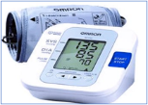
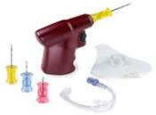
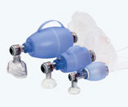
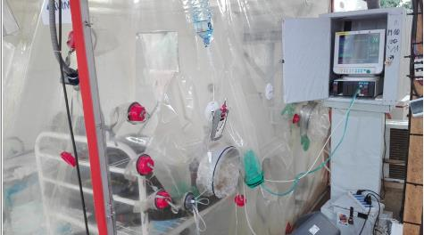
Structured approach to the management of a critically ill patient with suspected or confirmed FVD
The same approach is applied to any seriously ill patient
Preparedness
Trained and available staff in the right provider-to-patient ratio
Emergency equipment must be availble in suspect and confirmed wards
System of regular monitoring of all patients
Call for help! Assessment and immediate start of emergency care
Personal protective equipment (PPE)
A – Respiratory tract
B – Respiration
C – Circulation
D – “Disability” – ie neurologic involvement
E – Exposure/environment
See international guidelines, for example: APLS, PALS, ETAT, etc.
Notes:
Same initial management approach – regardless of underlying condition.
A supplementary management plan should cover major life-threatening conditions.

Slide 8
Assessment and emergency management
1
2
3
Observation
AVPU
Confusion, lethargy or restlessness
Seizures/Convulsions
Asymmetry in physical exam (pupils, strength, or reflexes)
Action
Protect against falls or injuries
Secure airway and put in recovery position if post-ictal and still breathing
Supplemental oxygen as required
Call for help, but do not leave the patient alone
Check
Blood glucose (and correct hypoglycaemic)
AVPU (monitor and record)
For the first 5 minutes
4
5
Active Seizures
Benzodiazepine IV or rectal route
Manage and monitor
Fever
Treat underlying causes

Slide 9
Seizures

Slide 10
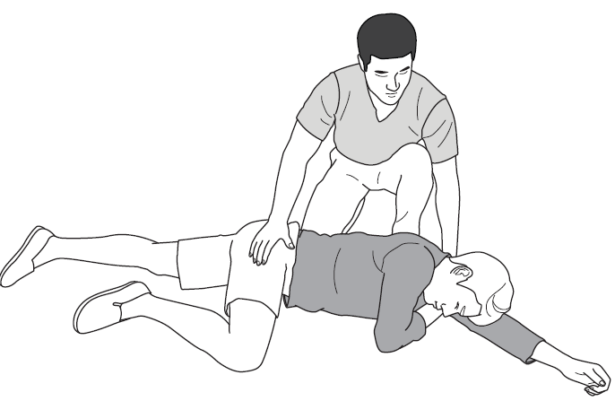
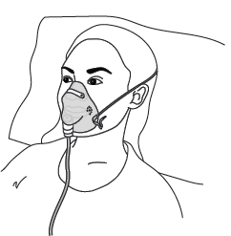
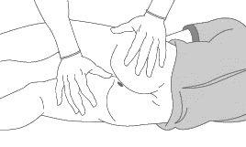



Seizures
Caution when treating a patient who is convulsing, if no existing IV access use PR route to minimize needle injuries
Lateral safety position
Oxygen therapy
Anticonvulsant PR/IV
Check and correct hypoglycaemia
Treat fever
Dextrose
Sources: Soins primaires d’urgence, approche du patient gravement malade ou blessé, OMS et CICR, 2021; The Royal Children’s Hospital Melbourne, Neurology, Rectal Diazepan, https://www.rch.org.au/neurology/patient_information/rectal_diazepam/
Notes:
Secure the patient and the airways, administer oxygen. Give the anticonvulsant intra-recally or IV (if possible). Then manage possible hypoglycaemia and fever.

Slide 11
Seizures
Which anticonvulsant to administer?
Diazepam IV or rectal gel (if no diarrhoea)
Phenobarbital IV
Phenytoin IV
Fever
Paracetamol
Adult: 1 g of paracetamol every 6–8 hours; max. dose = 4 g every 24 hours (or 2 g if history of chronic liver disease)
Newborn: orally 10–15 mg/kg 6 hours, max. dose 40 mg/kg/day; IV dose 7.5 mg/kg every 6 hours IV; max. dose 40 mg/kg/day
Other children: 10–15 mg/kg every 6 hours; max. dose 60/mg/day
Diazepam: 0.3 mg/kg/dose IV given over 3–5 minutes
every 5–10 minutes; max. dose 10 mg/dose
Notes:
Possible anticonvulsants are diazepan, phenobarbital and phenitoin.
Manage fever, if present, with both drug and non-drug measures. Avoid nonsteroidal anti-inflammatory drugs

Slide 12
Etiologies of seizures and encephalopathy in FVD
Instability of vital signs
Hypoxemia
/hypotension
Common infectious causes
Sepsis (co-infection)​
Non-infectious causes
Bacterial meningitis
Malaria
Acute meningoencephalitis (EVD/SUVD/MVD related)
Uremia/acute renal failure (ARF)
Hepatic encephalopathy
Hypertensive emergencies
Micro or macro cerebrovascular ischaemia
Intracranial haemorrhage
Electrolyte disorders (hyponatraemia, hypocalcemia,)
Hypoglycaemia

Slide 13
Look for the possible cause
Re-assessment:
Frequent reassessment as often as necessary:
Is the patient stabilized?
AVPU ( +/- changes in status)
Check the pupils
Check orientation (time, place, person)
Check temperature (and other vital signs if possible)
Check for neck stiffness
Check strength and sensation
Look for signs of dehydration
Abdominal examination
Skin examination
Nutritional status
Pain assessment
ABCDE + SpO₂
Electrolytes, blood glucose level
Liver/kidney function
Nutritional status and psychological support

Slide 14

Look for the possible cause
Laboratory investigation of metabolic causes
Remember specific causes
Hypoglycaemia
Hyponatraemia
Hypocalcemia
Alcohol withdrawal
Uraemia from acute renal injury
Hepatic failure​
Source: confidential (used with permission)

Slide 15
Managing underlying causes
Correct hypoglycaemia
Maintain adequate brain and vital organ perfusion
Treat shock, anaemia and dehydration
Monitor haemoglobin and transfuse if necessary
Correct electrolyte disorders: Na⁺, K⁺, Ca⁺⁺, Mg⁺⁺
Avoid aspiration – safe positioning, caution with oral intake if altered LOC
orogastric tubes can be used, but keep on free drainage (serious bleeding risk)
Assess for and treat severe infections (start treatment presumtively):
Sepsis
Meningitis
Malaria
Treat fever
Consider others, including HIV and TB screening

Slide 16
Altered status of consciousness and encephalopathy

Slide 17
Persistent encephalopathy
Differential diagnosis – pragmatic approach
Persistent encephalopathy = Persistent restlessness or impaired consciousness (lethargy/coma) despite stabilized perfusion i.e.
stable haemodynamic status
corrected electrolyte/glycaemic balance
Correction of organ dysfunction
Consider other diagnoses, if possible:
Lumbar puncture (meningitis, TB-meningitis?) – if no contraindications
HIV, syphilis, malaria testing
Alcohol withdrawal
Delirium

Slide 18
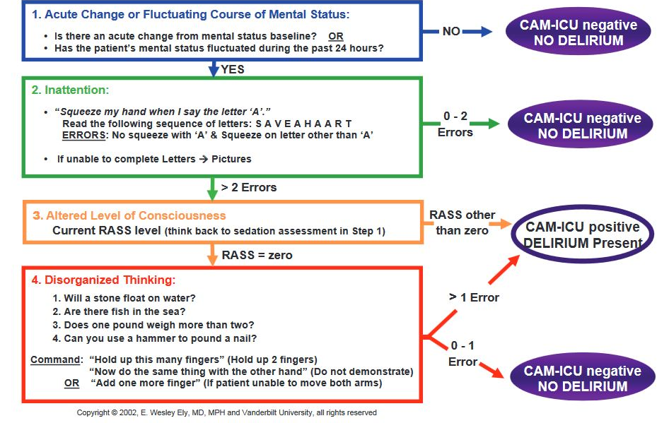
Screening for neurologic impairment
Tools like “Confusion Assessment Method for Intensive Care (CAM-ICU” are used in high resource settings (see right)
They are likely too time intensive in the Treatment Centre, and are not especially useful when delirium is obvious.
Notes:
It is important to assess whether the patient is not delirium. Several tools and methods exist (cfr Toolkit)

Slide 19
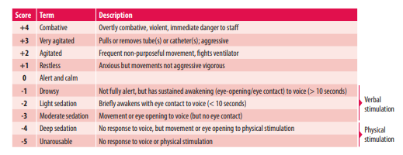
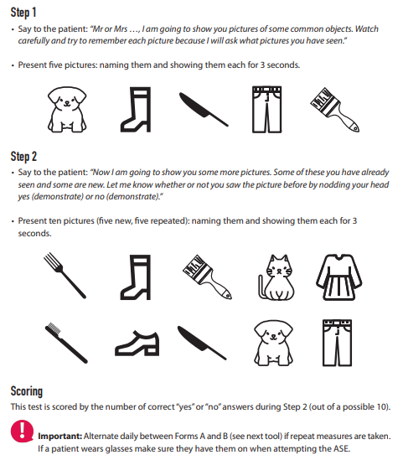
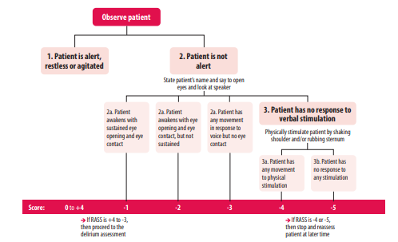
Source: WHO; Clinical Car e for Severe Acute Respiratory Infection—Toolkit—Update 2022
Notes:
It is important to assess whether the patient is not delirium. Several tools and methods exist (cfr Toolkit)

Slide 20

Altered status of consciousness and encephalopathy
Continue etiological and symptomatic treatments
Mobilization: Physiotherapy
Comfort, pain management, nutrition
Encourage visits from patient's family and friends
Remove catheters, IV lines when no longer needed
Encourage a normal sleep cycle with wake-up phases
Avoid sedatives. In case of agitation: haloperidol, if necessary
Treat the underlying cause
Monitor and plan the discharge and follow-up of patients with psychosocial support
Notes:
Caution with agitated or mentally altered patients. They can be a risk to themselves, other patients and caregivers. Treat the underlying causes, think about not only drug measures and psychosocial support.

Slide 21
Questions?

