Slide 1
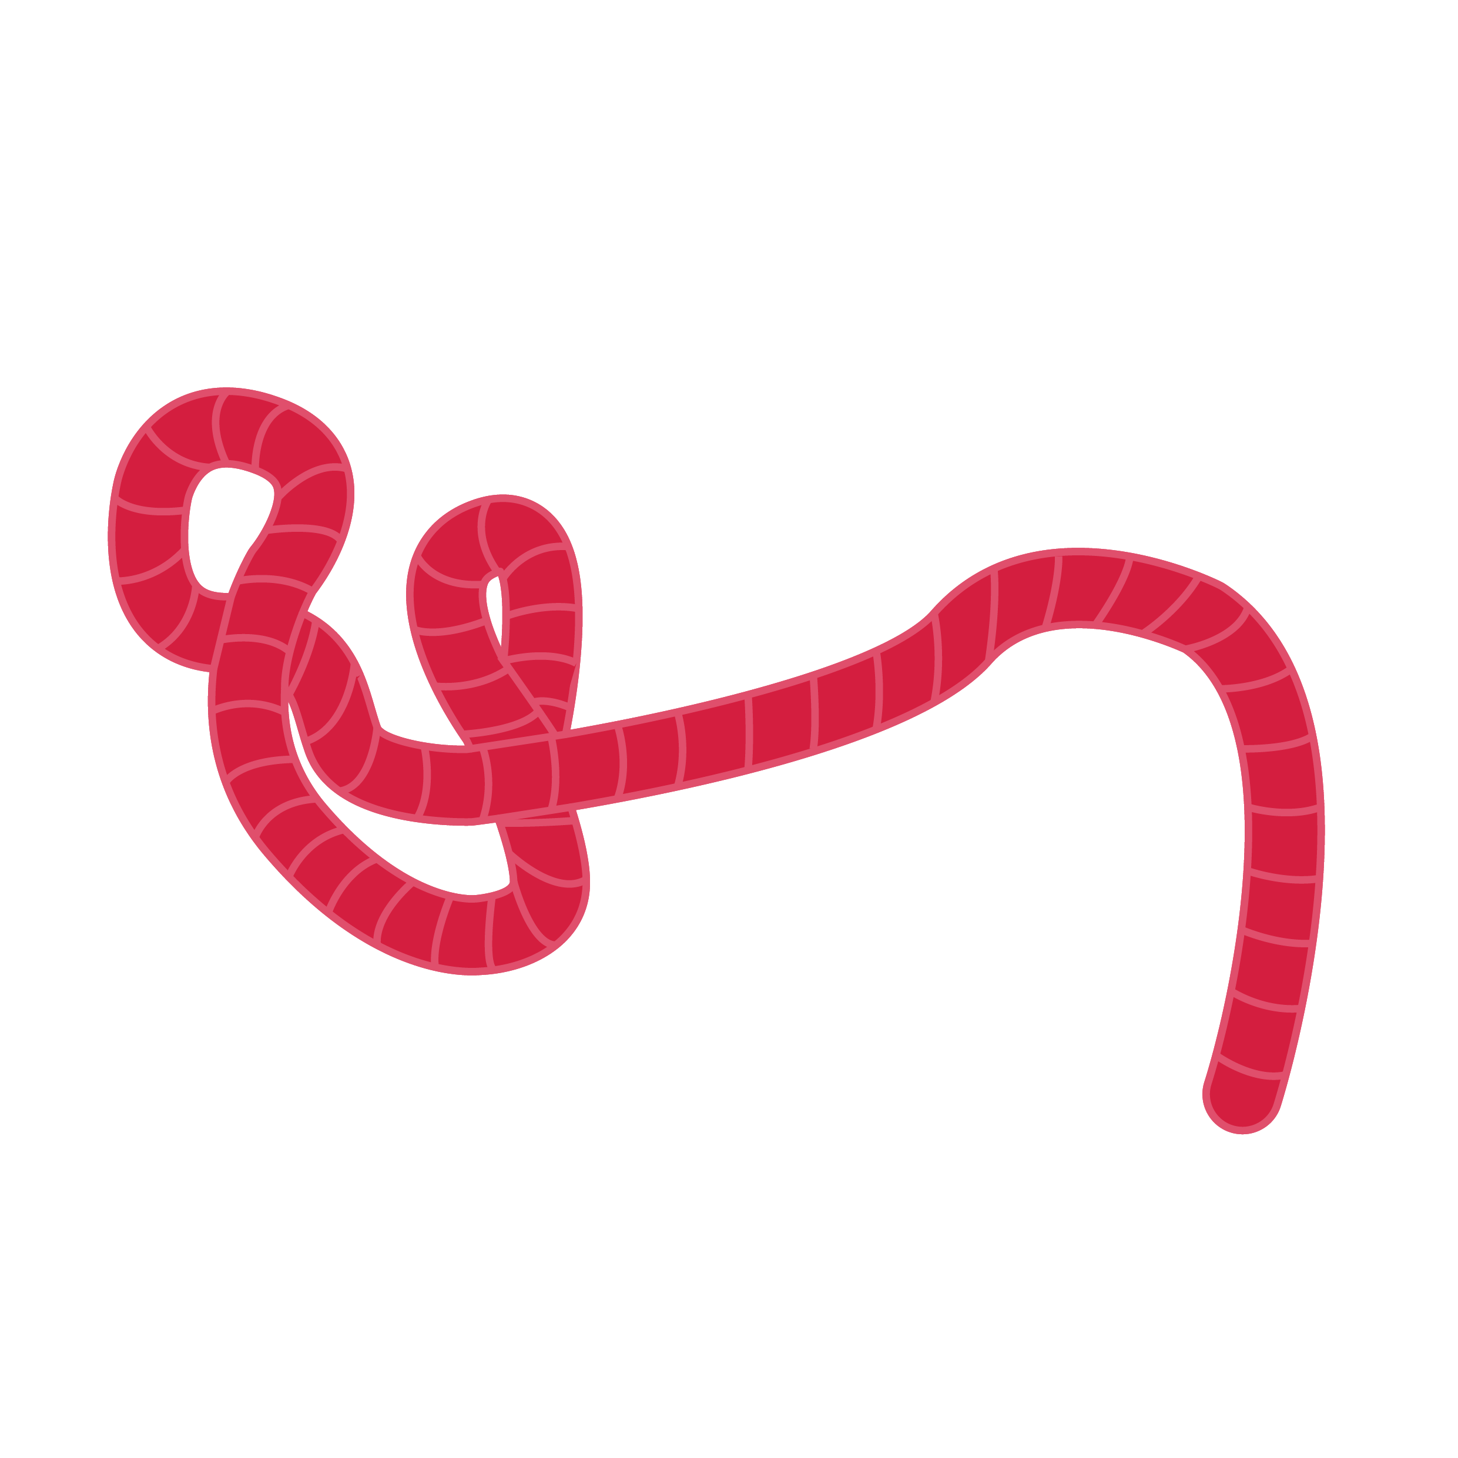
Haemorrhage Management
Advanced Filovirus disease
Case Management

Slide 2
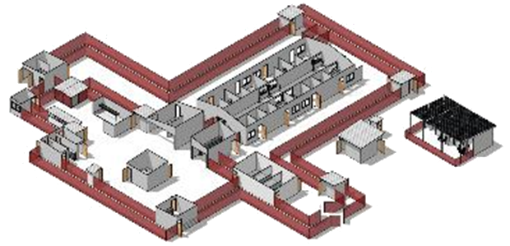
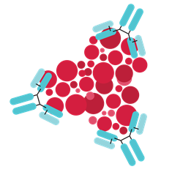
Life-saving management for Filovirus Disease patients:
Three key interventions
Design and biosecurity of Treatment Centre
Optimized supportive care
Specific therapeutics
(depends on the causative virus)
A facility centered around patients, staff, families and communities
A facility where patients can get quality care, compliant with all biosecurity standards and IPC
Not just an isolation room
Systematic assessment and monitoring of patients
Resuscitation with oral and IV fluids and vasopressors
Availability of point-of-care tests (biochemistry, haemoglobin, glucometer, malaria RDT) and use of oxygen and blood products
Prevention and management of complications (electrolytes management…)
Recommendation for the treatment of EBOV (Zaire ebolavirus):
  Ansuvimab (mAb114, Ebanga)
  Atoltivimab, maftivimab, odesivimab “cocktail” (REGN-EB3, INMAZEB)
No current specific therapeutic recommendations for other Ebolaviruses and Marburgviruses

Slide 3
Learning objectives
At the end of this session, you should be able to:
Describe the prevalence of haemorrhagic manifestations in FVD Ebola and Marburg patients
Understand the management of a patient with shock with and without bleeding
Describe the monitoring and prevention of a patient with bleeding

Slide 4
Presentation outline
History of bleeding in Ebola and Marburg disease
Assessment
Haemorrhage management
Monitoring

Slide 5

History of bleeding in Ebola and Marburg Disease
Onset of symptoms
Clinical evolution of Ebola: focus on haemorrhage
Early phase
Peak phase
Recovery phase
Non-specific signs: fever, asthenia, anorexia, myalgia, headache
Gastrointestinal symptoms: nausea, vomiting, diarrhoea, abdominal pain
What is the frequency of bleeding in FVD patients?
What is the management of haemorrhage in Treatment Centres?
Skin rash
Haemorragic manifestations
Kidney failure
Respiratory failure
Neurological manifestations
Heart failure (myocarditis and pericarditis)
Uveitis
DAY 0
D7
D14
D21
D28
Source: Jacob ST, Crozier I, Fischer WA et al. Ebola virus disease.
Nat Rev Dis Primers. 2020;6(13). https://doi.org/10.1038/s41572-020-0147-3.

Slide 6
History of bleeding in Ebola and Marburg Disease
Key questions
What is the actual prevalence of haemorrhagic symptoms and signs in (human) FVD?
  Contrary to many beliefs, haemorrhage is not a frequent manifestation of FVD
  Haemorrhage is a late manifestation of FVD
    associated with high viral loads and advanced disease
  Bleeding at IV sites in 14 of 27 patients (52%) and "frank bleeding" in 2 of 27 patients (7%), in Ebola patients who were treated in Europe and USA
  Source: Uyeki TM, Mehta AK, Davey RT et al. Clinical management of Ebola virus disease in the United States and Europe. NEJM. 2016;374:636-646.

Slide 7
Assessment
How to manage bleeding?
Management will depend on the site and severity of the bleeding
Sites
Bleeding can be internal and/or external:
  vaginal (associated with pregnancy)
  gastrointestinal (i.e. haematemesis, melena)
  intracranial haemorrhage
  IV site
  membranes and mucosa

Slide 8
Assessment
How to manage bleeding?
Severity
Massive bleeding can cause shock, usually defined as follows:
  bleeding > 150 mL/min
  > 50% blood volume loss in 3 hours
  more pragmatically, blood loss leading to shock syndrome (rare in FVD)
Notes:
Anaemia, Dr T. Wuillemin, Hôpitaux universitaires de Genève, Département de médecine communautaire, de
Primary care and emergencies
https://www.hug.ch/sites/interhug/files/structures/medecine_de_premier_recours/Strategies/strategie_anemie.pdf

Slide 9
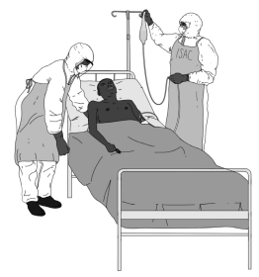
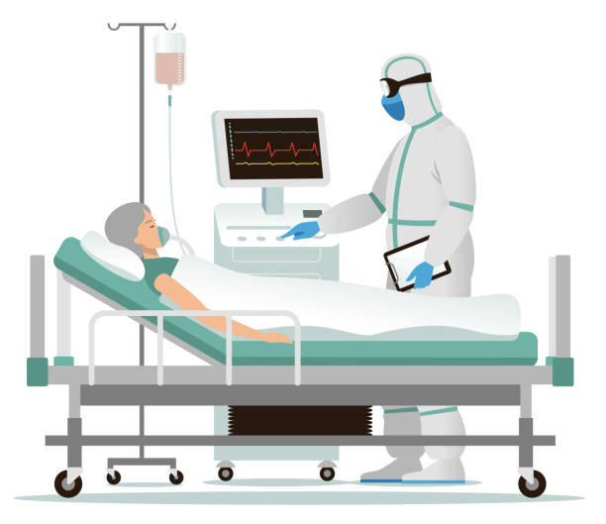
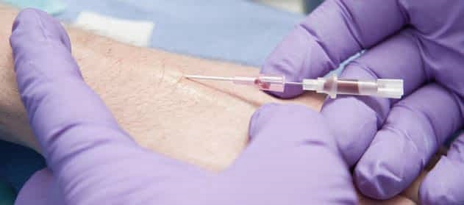
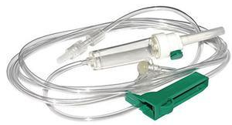
Haemorrhage management
Prevention
  In critically ill patients at high risk of bleeding (bleeding diathesis (eg platelet <50,000, INR >1.5, APTT >2 times control value), chronic liver disease, occult GI bleeding, glucocorticoid therapy, mechanical ventilation): proton pump inhibitor (PPI) or H2 receptor blocker
  Ranitidine: be careful – IV doses and oral doses are not equivalent
Structured approach (oSoC)
Stabilizing the patient
Place 2 large bore IV or IO venous port
Measure Hb, platelets and coagulation studies
Administer a bolus of crystalloid fluid
Warm the patient (emergency blanket, blankets)
Notes:
Data supports the use of stress ulcer prophylaxis in the following ICU patients:
Bleeding diathesis (eg, platelet count <50,000 per m3, an international normalized ratio [INR] >1.5, or a partial thromboplastin time [PTT] >2 times the control value)
●Mechanical ventilation for >48 hours especially those who are not being enterally fed
●Chronic liver disease
●History of GI ulceration or GI bleeding within the past year
●Traumatic brain injury, traumatic spinal cord injury, or burn injury
●Two or more of the following minor criteria: sepsis, an ICU stay more than one week, occult GI bleeding for six or more days, or glucocorticoid therapy (more than 250 mg hydrocortisone or the equivalent)
●On nonsteroidal antiinflammatory or antiplatelet agents

Slide 10

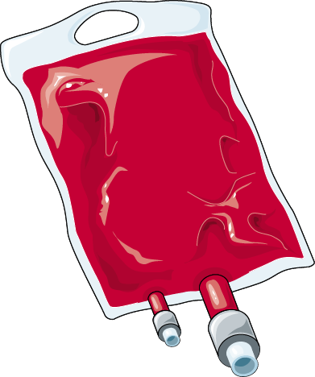
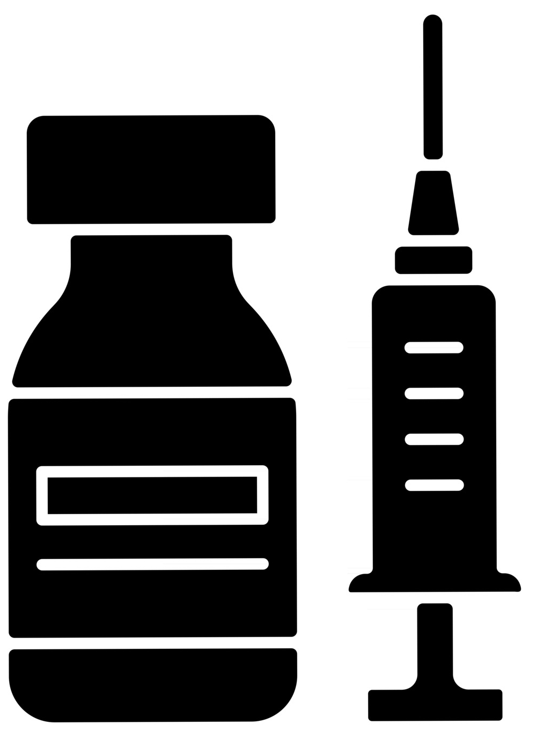

Haemorrhage management – in patients with GI bleeding
Consider transfusion if there is active bleeding and haemodynamic instability or Hb <7 g/dL
Transfusion
Target to Hb >7 g/dL
  packed cells 10 mL/kg in 3–4 hours
  (fresh whole blood if necessary 20 mL/kg in 3–4 hours)
Target INR < 1.5 (Fresh plasma)
Target platelets > 50 000/mm³ (platelet transfusion)
Gastrointestinal bleeding
High-dose proton pump inhibitor: Pantoprazole IV or Omeprazole IV
Adults: 80 mg IV pantoprazole over 60 min then 8 mg/hour for 72 hours continuous infusion or omeprazole 40 mg IV, twice daily
Children 0.5–3 mg/kg IV per day, in 1 or 2 divided doses (max. 80 mg per day)
CAUTION: blood needs to be cross matched and tested for transfusion transmittable infections

Slide 11
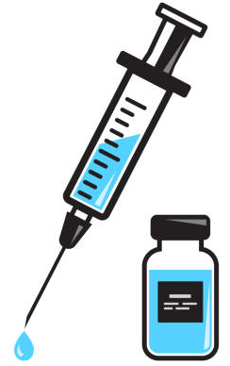
Haemorrhage management
Other options
Vitamin K: IV
Newborn: 1 mg; children: 1–2 mg; adults: 5–10 mg
Tranexamic acid IV
Adults: 1 g (in 100 mL 0.9% NaCl) in 10 min, then 1 g every 8 hours
Children: 15 mg/kg IV loading dose (max 1 g), then 10–15 mg/kg (max 1 g) every 8 hours
No direct evidence for the use of Tranexamic acid or vitamin K for treatment of bleeding in FVD but extrapolation from other bleeding conditions may support their use.

Slide 12
Monitoring
Clinical signs
Vital signs
Visible bleeding
Appearance of stool
Signs related to tissue hypoxia (e.g. pallor of the conjunctiva, asthenia, dyspnoea on exertion, headache, dizziness, impaired consciousness, etc.)
Signs related to the compensatory hyperdynamic state (palpitations, leaping pulse)
Signs related to hypovolemia: hypotension, orthostatism, mottling, oliguria
Laboratory
Regularly monitor Hb levels in critically ill patients: Hemocue
Hypocalcaemia is a complication of transfusion – monitor and correct it, if necessary

Slide 13
Monitoring
Monitor and manage transfusion reactions
Low severity reactions: mild hypersensitivity, such as urticaria
severe urticarial reactions
possible bacterial contamination (early signs)
fever
Life-threatening reactions
acute intravascular haemolysis
bacterial contamination and septic shock
volumetric overload
anaphylactic reactions
acute respiratory distress associated with transfusion

Slide 14
Questions?

