Slide 1
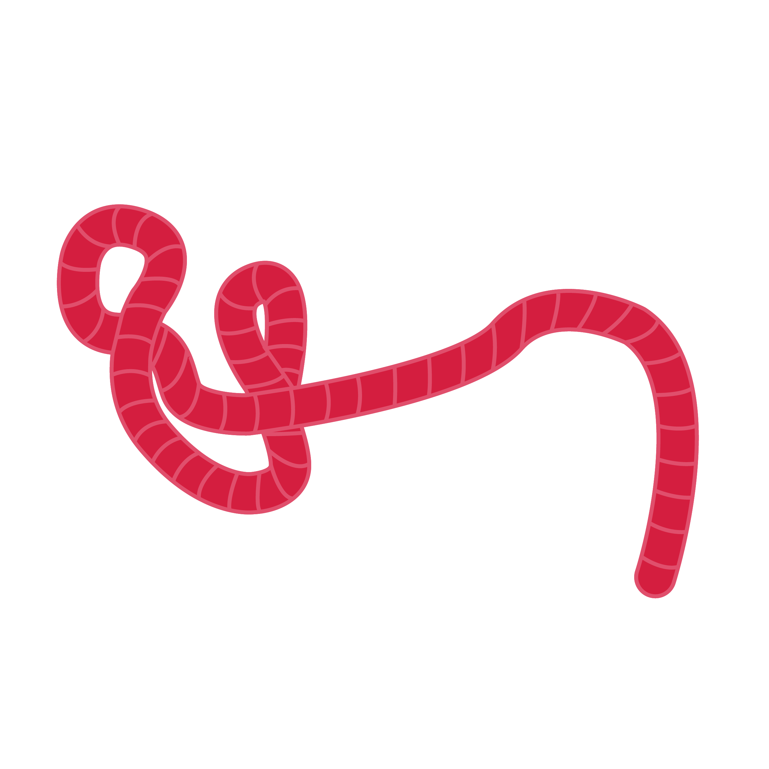
Shock and haemodyamic instability
Advanced Filovirus Disease Clinical Management

Slide 2
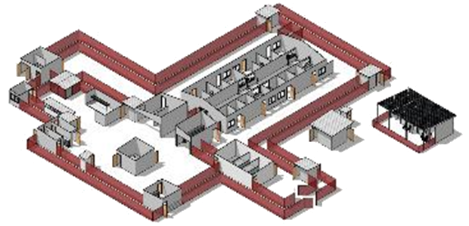
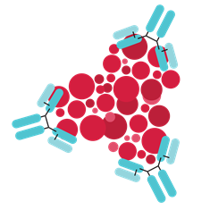
Life-saving management strategy for FVD patients: three key interventions
Design and biosecurity of Treatment Centre
Optimized supportive care
Specific therapeutics
(depends on the causative virus)
Not just an isolation unit
A facility focused on patients, staff, families and communities
A facility where patients can get quality care, compliant with all biosecurity standards and IPC is available
Systematic assessment and monitoring of patients
Resuscitation with oral and IV fluids
Availability of point-of-care tests (biochemistry, electrolytes, haemoglobin, glucometer, malaria RDT, ) and use of oxygen and blood products
Prevention and care of complications
Recommendation for the treatment of EBOV (Zaire ebolavirus):
Ansuvimab (mAb114, Ebanga)
Atoltivimab, maftivimab, odesivimab “cocktail” (REGN-EB3, INMAZEB)
No current specific therapeutic recommendations for other Ebolaviruses and Marburgviruses

Slide 3
Learning objectives
At the end of the session, you should be able to:
Recognize and list the signs of severe haemodynamic instability
Describe the different steps in the management of a patient with haemodynamic instability including shock and/or severe dehydration
Know how to manage fluid resuscitation in non-emergent situations including the use of maintenance fluids and volume resuscitation of patients with non-severe dehydration
List the targets of perfusion
Identify the signs and symptoms of volume overload

Slide 4
Presentation outline
Recognize haemodynamic instability
types of shock (septic, hypovolaemic, haemorrhagic)
severe dehydration
Manage the emergency
systematic management of shock
appropriate use of oral and intravenous fluids and vasopressors
Re-assessment and management
Maintenance fluids and replacement of fluid losses
Clinical management of moderate and mild dehydration
General supportive care in the Treatment Centre

Slide 5
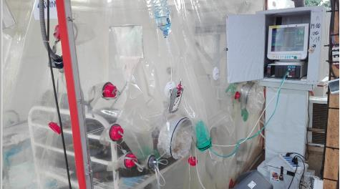
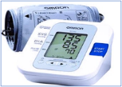
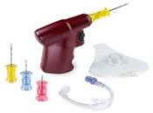
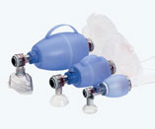
Structured approach to the management of a severe or critically-ill patient with suspected or confirmed Ebola
Same approach as for any severe or critically- ill patient
Preparedness
Trained and available staff in the right provider-to-patient ratios
Emergency equipment must be available in both suspect and confirmed wards
System of regular monitoring of all patients
Call for help! Assess and provision of immediate emergency care
Personal protective equipment (PPE)
A – Respiratory tract
B – Breathing
C – Circulation
D – Disability
E – Exhibition/environment
See international guidelines, for example: FLATS, PALS, STATE, Treatment Centre.
Notes:
Same initial management approach - regardless of underlying condition.
A supplementary management plan should cover major potentially life-threatening conditions.

Slide 6
Recognize hemodynamic instability

Slide 7
Recognize haemodynamic instability
Often, FVD patients have or develop signs of one or more of the following syndromes:
Volume depletion (dehydration)
Sepsis
Septic shock
Haemorrhage
Important to look for:
Signs of dehydration
Signs of sepsis
Signs of septic shock
Severity and source of bleeding
Shock is an emergency. Ensure early recognition and intervention.
Notes:
Early detection of signs of sepsis, volume depletion and bleeding is essential. Take care of them quickly. They can cause shock

Slide 8
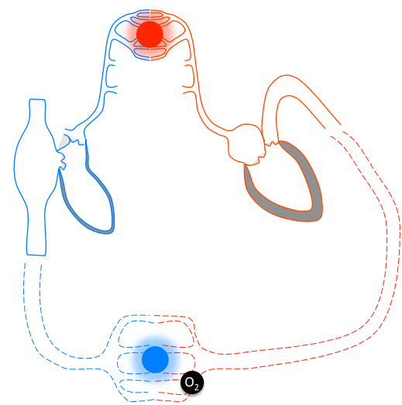
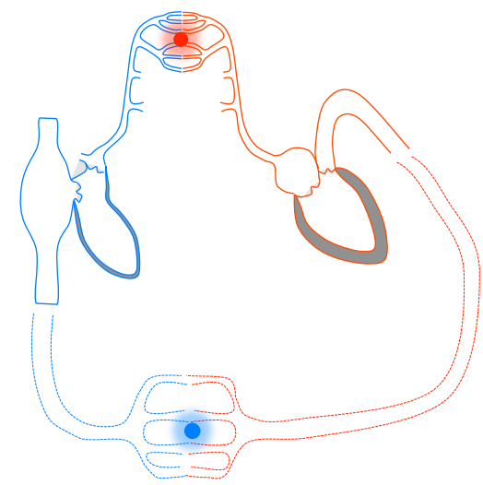
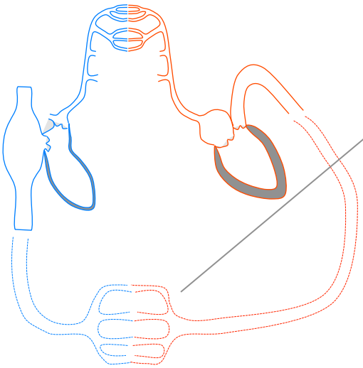
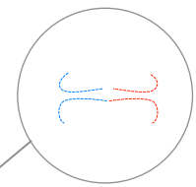
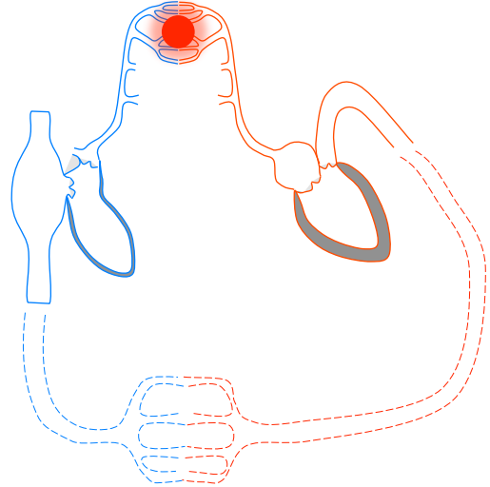
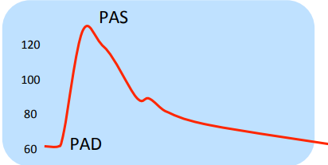
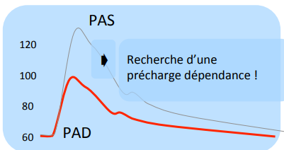
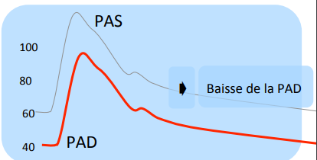
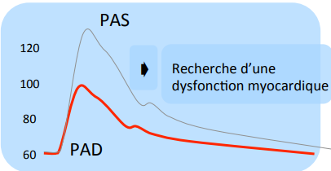
Recognise haemodynamic instability
Haemodynamic instability mechanism of shock
Hypovolaemia
Vasodilation
Myocardial depression
Look for preload dependency (does the blood pressure improve after fluid challenge?)
Reduced systemic vascular resistance
Inability of the heart to create sufficient pulse pressure
Notes:
Les mécanismes d’instabilité hémodynamique dans le choc peut se résumer en 3 points notamment l’hypovolémie, la vasoplégie et la dépression myocardique.

Slide 9
Recognise haemodynamic instability
 | Hypovolaemic shock | Septic shock | Cardiogenic shock
Hypovolemia
Vasodilation
Myocardial depression
Inotropic support
Vascular filling
 | Hypovolaemic shock | Septic shock | Cardiogenic shock
Hypovolemia
Vasodilation
Myocardial depression
Vasopressor
It is very common for more than one mechanism of shock to occur at the same time
Notes:
Instability mechanisms can explain the occurrence of each type of shock listed here.
However, they are not as simplified since several mechanisms can be present in the different shocks.

Slide 10
Recognise haemodynamic instability
Hypotension
CRT ˃ 3 seconds
Tachypnoea
Tachycardia
Cold extremities
And/or decreased diuresis
Hypovolaemic
Septic
Haemorrhagic
History of diarrhea and vomiting
Dehydration
Increased or decreaed temperature
Signs of infection
Internal or external bleeding
PLUS
In FVD, haemorrhage is rarely sufficient to cause shock - must consider additional or alternative etiologies
Notes:
Clinically, the recognition of types of shock in EVD can be guided by the general signs of hypoperfusion plus certain signs/symptoms in favor of one or the other.

Slide 11

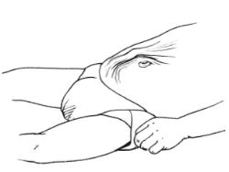
Recognition of a haemodynamic instability
How to recognize severe dehydration?
 | Mild dehydration ( 3-5% body mass) | Moderate dehydration ( 6-9% of body mass) | Severe dehydration ( >10% of body mass)
Pulse | Normal | Rapid | Rapid, week
Systolic Blood Pressure | Normal | Normal or low | low
Oral mucosa | Mildly dry | Dry | Very dry
Skin texture | Normal |  | Poor, slow
Urinary output | Normal (Adult > 0.5mL/kg/h infants > 1 mL/kg/h) | Adults <0.5mL/kg/h infants < 1 mL/kg/h | Very low or anuric(< 0.5 mL/kg/h x 3 hours or more)
Respiratory Rate | Normal | High | High
Others |  |  | Sunken fontelle in infants Cold, mottled skin
Notes:
Like any hemodynamic instability, do not miss severe dehydration.
However, thinking about the shock directly if an association with
Adult: SBP < 90 mm Hg or other clinical signs of hypoperfusion despite filling
Child: CRT > 3 seconds; cold extremities; weak and rapid pulse or age-related hypotension (SBP < 70 + [age in years x 2]).

Slide 12
Managing the emergency
Manage the emergency

Slide 13
Managing the emergency
Shock is a life-threatening clinical emergency
Shock causes circulatory dysfunction which results in:
reduced supply of O₂ (and other nutrients) to tissues
reduced elimination of metabolites
cellular dysfunction
Shock is an imbalance between O₂ supply and O₂ demand of cells and tissues affecting all vital organs
neurological function
kidney function
cardiac function
respiratory function
others
Physiopathology of shock
O₂ supply < O₂ demand
Notes:
Modification of the definition according to the WHO update document.
Another definition to be clarified
13

Slide 14
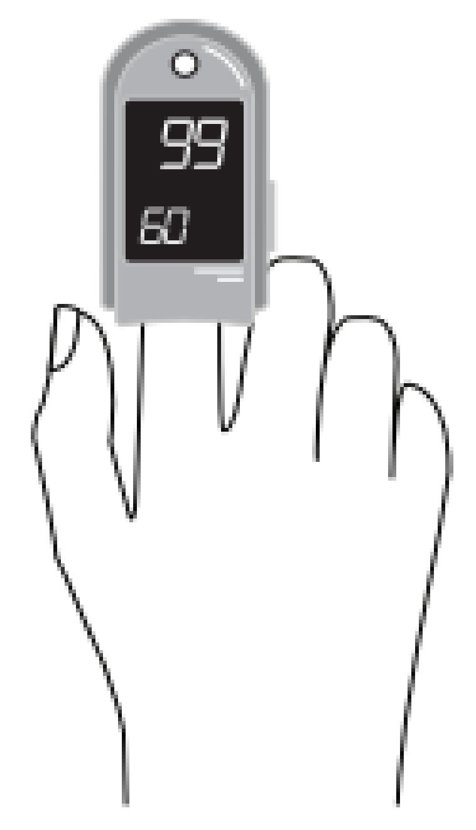
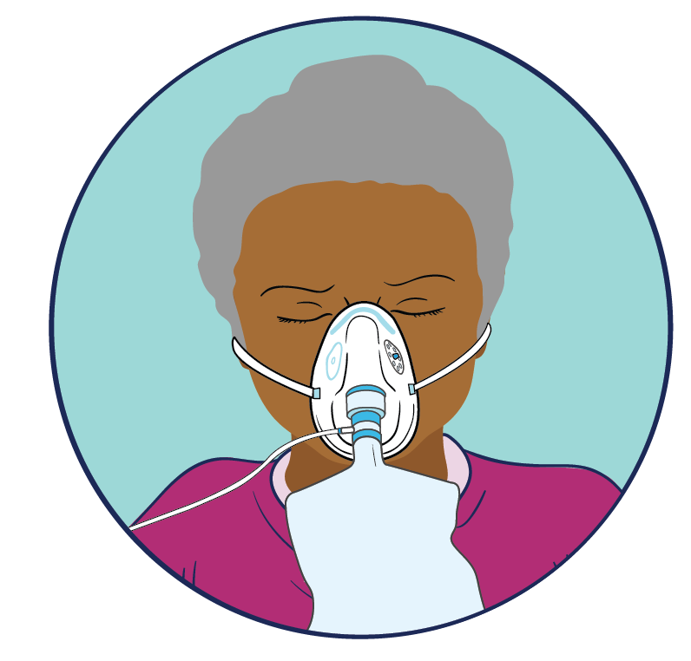
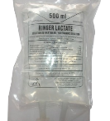
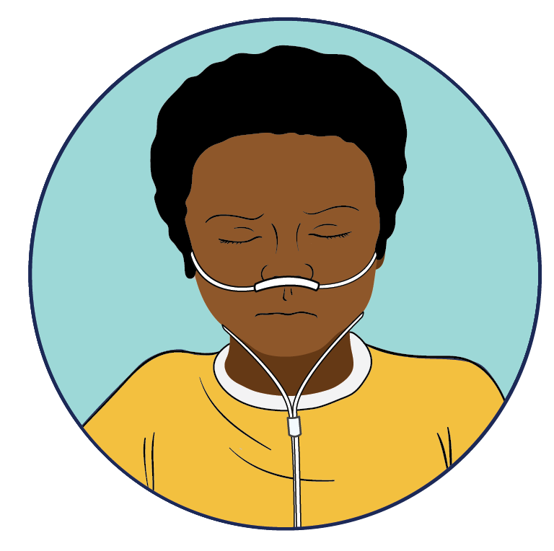
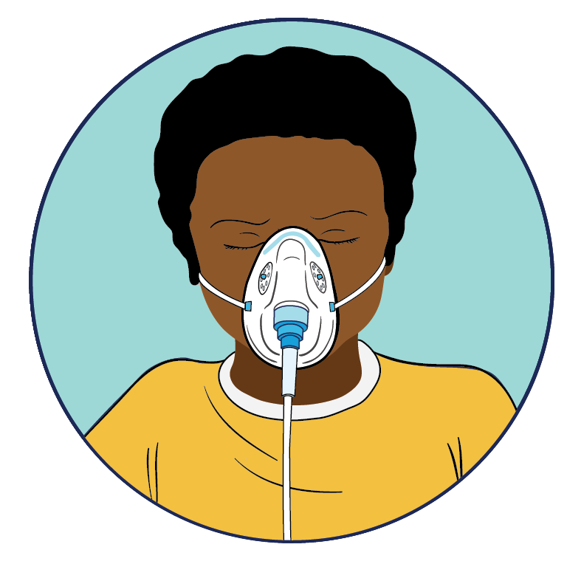
Managing the emergency
Systematic shock management
Signs of shock
1
SpO₂ < 94%
YES
NO
2
Fluid resuscitation
Place secure IV or IO access
Administer the initial fluid bolus
Crystalloid solutions: Ringer’s lactate or 0.9% Saline
Blood transfusion if indicated
Oxygen therapy (SpO₂ target > 94% )
Face mask with reservoir at 10–15 L/min
Use nasal prongs +/- mask in children
Notes:
In the face of clinical signs evoking shock, check the partial oxygen saturation. If it is below 94%, start with oxygen therapy to raise this saturation.
If higher than 94%, start directly with fluid resuscitation

Slide 15
Managing the emergency
If not responding
If shock still present,
take further action
Fluid challenge: intial management
Place 2 large gauge access (IV or IO)
Infuse isotonic crystalloid liquid: RL or NaCl 0.9%
Determine the quantity and flow rate of fluids
Child
Initial bolus: 10–20 mL/kg
for 30 to 60 minutes
Reassess
10 mL/kg
over 30 minutes
If shock still present,
take further action
If not responding
Bolus of 500mL
Administer in increments of 500 mL
Give another bolus
Up to 30 mL/kg in 1st three hours or until
normalization of perfusion
If shock still present,
Consider vasopressors
Adult
Reassess
Notes:
Initiate fluid management in the face of shock syndrome. Recall that more likely shock in EVD is hypovolemic or sepsis.
Use isotonic crystalloid solutions

Slide 16
Managing the emergency
Systematic shock management
2
Fluid resuscitation
Re assessment
Vital signs every 30 min to assess response to fluid challenge
Markers of adequate perfusion
SBP > 90-100 mmHg in adults, or age appropriate in children
Good peripheral pulse
RR normal
Normal state of consciousness (AVPU)
Urinary output: > 0.5 mL/kg/h in adults; > 1.0 mL/kg/h in children
CRT < 3 seconds
Stop fluid challenge
Maintenance fluid (IV or oral depending on the patient)
Vital signs once per hour
YES
Are infusion targets met?
NO
Signs of fluid overload
Dyspnoea, drop in SpO₂
RR augmented
Raised JVP
Peripheral oedema
Hepatomegaly (child)
3
Is there fluid overload?
Notes:
Within 30 min after the first bolus, reassess the patient. If infusion targets are met, stop refill challenge and start with maintenance fluids
If infusion targets are not achieved, check for signs of overload for further management

Slide 17
Managing the emergency
Pay attention to rapid fluid resuscitation in case of:
Anaemia (Hb < 50 g/L)
Consider careful rehydration while waiting for blood transfusion
Severe acute malnutrition (SAM)
10–15 mL/kg, 60 min, max. 30 mL/kg
See Plan C
Severe dehydration
Notes:
Adjust the flow of liquids according to certain situations, particularly in the face of severe acute malnutrition, anemia and isolated severe dehydration.

Slide 18
Managing the emergency
Systematic shock management
3
Is there a fluid overload?
YES
NO
Repeat fluid challenge and reassess the perfusion targets*
Compensate for fluid losses
Stop fluid challenge
4
Refractory shock
No response
General care in the Treatment Centre
Administer vasopressors:
Epinephrine/norepinephrine
Consider dopamine as an alternative (preferred in children)
TITRATE inotrope/vasopressor dose to clinical response
Notes:
If there is fluid overload after the first bolus and no response to fluid resuscitation, stop fluids and think directly of refractory shock.
If there are no signs of overloading, repeat the filling test. If response, stop and maintenance fluid. If no response, conclude with refractory shock.
In case of refractory shock, start with inotropic vasopressors.
Think of a global management of the shock at the level of the CTE, in particular antibiotic if sepsis, …
oSOC

Slide 19
Managing the emergency
Vasopressors/inotropes
When to give vasopressors?
Signs of fluid overload
AND/OR
Have not met perfusion goals
If fluid resuscitation well conducted
+
*Adult: 30 mL/kg in the first 3 hours
*Child: 40–60 mL/kg in the first 2 hours
DO NOT delay starting vasopressors when evaluating response to fluid resuscitation it is essential to establish and maintain good organ perfusion as early as possible.
Vasopressors can be initiated during fluid resuscitation and weaned off as the patient responds.
SBP > 90–100 mmHg in adults (or MBP >65mmHg)
Age-appropriate SBP and infusion in children
Notes:
In the face of refractory shock, consider starting with vasopressors.
Do not delay their use, they can start during volume expansion, the main thing being to maintain good organ perfusion..

Slide 20

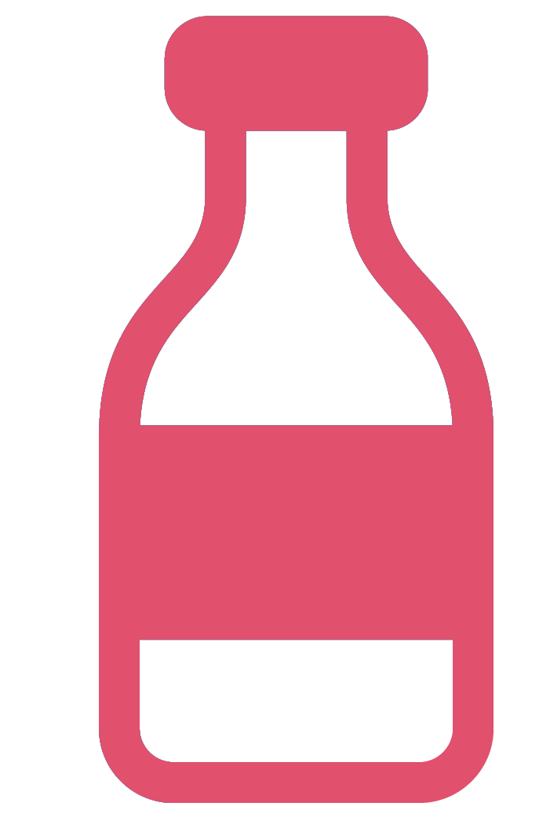
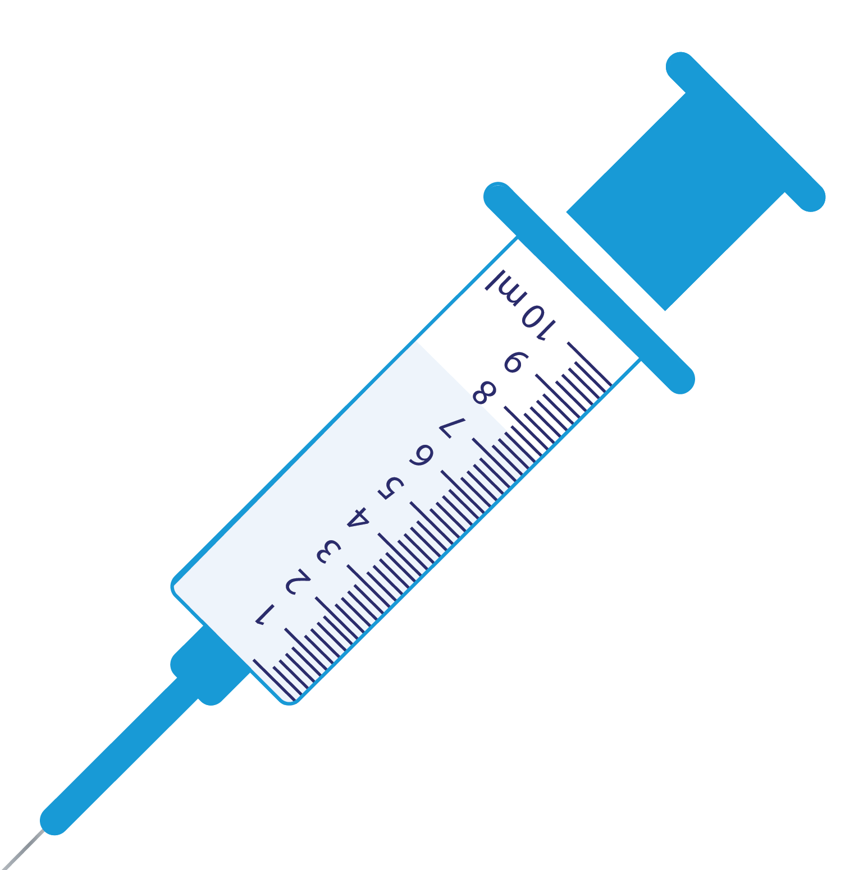

Manage the emergency
Vasopressors/inotropes
How to give vasopressors?
Norepinephrine, 4 mg = 4 mL of 1:1000
Adrenaline 4 mg = 4 mL of 1:1000
50 mL of D5
Remove 4 mL = 46 mL
Add 4 mL Norepinephrine or Adrenaline to 46 ml de D5
Adult
Concentration : 80 μg/mL
* total volume 50mls
Norepinephrine, 1 mg = 1 mL of 1:1000
Adrenaline 1 mg = 1 mL of 1:1000
50 mL of D5
Remove 1 mL = 49 mL
Add 1 mL Norepinephrine or Adrenaline to 49 ml de D5
Child
Concentration : 20 μg/mL
* total volume 50mls

Slide 21
Managing the emergency
Vasopressors/inotropes
How to give vasopressors?
Place the syringe in the electric syringe pump
Initial dose: 0.1 μg/kg/min, increase the dosage by 0.1 μg/kg/min every 10–15 min
Usual maintenance dose: 0.25–0.5 μg/kg/min
max. dose: 1 μg/kg/min
norepinephrine or epinephrine
Dopamine (alternative) (to be preferred in children)
Initial dose: 5 μg/kg/min, increase the dosage by 2.5 μg/kg/min every 15 min
Max. dose: 20 μg/kg/min
Notes:
If possible, use the syringe pump. The alternative choice is dobutamine, which is preferred in children.

Slide 22
Manage the emergency
Vasopressors/inotropes
Close haemodynamic monitoring
Ensure sufficient numbers of trained staff are available for monitoring and treatment
Titrate
Use the lowest dose needed to reach the infusion target
If perfusion markers stable/improving, reduce vasopressor dose
Monitor the IV site to ensure there are no signs of extravasation
Check perfusion markers at least every 30 minutes
Notes:
The administration of vasopressors requires close monitoring of perfusion markers.
Have qualified personnel ready to intervene if necessary.

Slide 23
Continuing clinical assessment
Manage the emergency

Slide 24
Continue clinical assessment and management of Dehydration
How to classify moderate and mild dehydration?
 | Mild dehydration (weight loss 3–5%) | Moderate dehydration (weight loss 6–9%) | Severe dehydration (weight loss > 10%)
Pulse | Normal | Fast | Fast, weak, rapid
Systolic Blood Pressure | Normal | Normal or low | Low
Oral mucosa | Slightly dry | Dry | Dry
Skin texture | Normal |  | Skin cold, poor tugor
Urinary output | Normal > 0.5 mL/kg/h in adults > 1 mL/kg/h in children | Less than < 0.5 mL/kg/h in adults Infants < 1 mL/kg/h over 3 hours | Very low or anuric (< 0.5 mL/kg/h over 3 hours)
Respiratory Rate | Unchanged | Increased | Increased
Others |  |  | Depressed fontanelle Skin cold, mottled skin
Notes:
Après un traitement hydrique, il est toujours nécessaire de réévaluer et de classifier la déshydratation
Le patient peut passer de la sévérité à la déshydratation modérée ou légère.

Slide 25
Management of Severe Dehydration Without Shock
Place 2 large gauge access ( IV or IO)
Infuse
RL or NaCl 0.9% + SG10% (SG5% if > 1 year)
ORS if patient can drink and check weight
Determine the quantity of IV fluid: 100 mL/kg
Determine flow rate
(Plan C)
1st fluid bolus
30 mL/kg
Reassess
2nd fluid bolus
70 mL/kg
Child ˂ 12 months
1 hour
Reassess the child every 30 min.
If no improvement: infuse fluids more quickly
ORS (5 mL/kg/h) as soon as the patient can drink
5 hours
Child > 1 year (and adult)
Pay attention to the development of shock which may need additional circulatory support
30 minutes
2.5 hours
Notes:
Source: WHO Child Hospital Care (modify at end). It is recommended to give 100 ml/kg, adjusting the rate according to age and weight. Reassess the patient regularly, start ORS as soon as possible, and remember to reclassify dehydration after taking IV fluids.
If signs suggestive of shock present, refer to shock algorithm for management

Slide 26
Continuing clinical assessment and management
Monitor every hour
For dehydration, reclassify as moderate or mild
Always watch for signs of fluid overload
Check the biochemistry and haemoglobin:
Biochemistry (hypokalaemia is very common, and sodium abnormalities may also need correction [hypo or hypernatraemia])
haemoglobin (the presence of anemia can change how patients are volume resuscitated)
Notes:
Une fois le choc levé, poursuivre la surveillance clinique et paraclinique et ajuster le traitement.
Notamment maintenir l’état hydrique du patient

Slide 27
Continue clinical assessment and management
Fluids in moderate and mild dehydration?
Assessing and reclassifying the patient
Assessing and reclassifying the patient
Severe dehydration/shock
Moderate dehydration
No dehydration
Plan A
Water or ORS as required
If watery stool, ORS 5–10 mL/kg
Plan B
ORS (or else IV) for 4h
Patient’s weight (in kg) x 75
Estimated weight 1–10 years = {age in years +4} x 2
Plan C
Weight | ORS to be administered
< 5 kg | 25–50 mL
5–10 kg | 50–100 mL
10–20 kg | 100–200 mL
Or up to 2 years ≥ 50–100 mL Above 2 years ≥ 100–200 mL
> 20 kg: administer > 200 mL and estimate losses
Patient’s weight | < 5 kg | 5–8 kg | 8–11 kg | 11–16 kg | 16–30 kg | ˃ 30 kg
Quantity of ORS in mL | 200–400 | 400–600 | 600–800 | 800–1200 | 1200–2200 | 2200–4000
Notes:
Sources: paediatric hospital care

Slide 28
Continue clinical assessment and management
Maintenance fluids and continuous fluid losses
What fluids to give?
Oral preference: ORS (possible to add fruit juice)
IV fluids if unable to drink or acute illness
crystalloid liquids: RL or NaCl 0.9%
add dextrose to the solution, if continuous glucose infusion is required
regularly reassess any patient receiving IV infusion to avoid volume overload
Routine losses (vomiting, diarrhoea ...
Total fluid intake
Daily maintenance fluids
+ replacement of fluid losses
Insensible losses
Notes:
The oral route is generally preferred to meet daily maintenance fluid requirements, but is difficult in patients with acute disease and should be supplemented with IV infusions as needed.

Slide 29
Continue clinical assessment and management
How to calculate maintenance fluids?
In children and adults, estimate the daily needs as follows
100 mL/kg/day for the first 10 kg (1 L)
50 mL/kg/day for the second 10 kg (1.5 L)
20 mL/kg/day for each kg > 20 kg
In adults, this approximates to 1.5–2L/day at a minimum
For febrile patients, need to take into account insensible losses: approximately 2.5 mL/kg/day for each degree above 37°C.
Example:
1 patient of 16 kg, will receive: (100 mL x 10) + (50 mL x 6) = 1300 mL/day
1 patient of 62 kg will receive:
Afebrile: (100 mL x 10) + (50 mL x 10) + (20 mL x 42) = 1500 + 840 mL = 2340 mL/day
If temperature of 38.5°C, add 2.5 x 62 x 2 = 310 mL/day.
TOTAL fluids: 2340 + 310 = 2650 mL/day
Notes:
Calculate the amount of fluids to give. Adjust the in the febrile patient taking into account the insensible losses

Slide 30
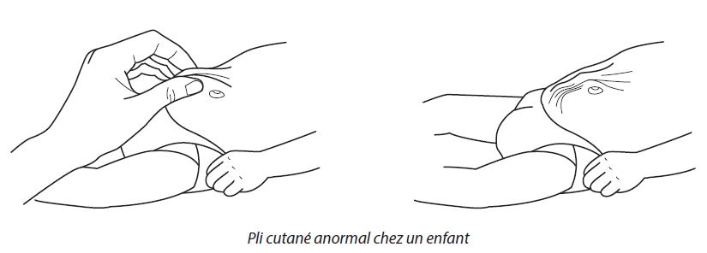
Continue clinical assessment and management
How is dehydration managed?
Include zinc for patients with diarrhoea
Age < 6 months 10 mg per day – for 10 days
Age > 6 months 20 mg per day – for 10 days
Notes
Include parents and patient’s carers in management of patient; inform: danger signs/diarrhoea, vomiting/urinating
Source: WHO paediatric hospital care
Notes:
Sources: paediatric hospital care and oSOC

Slide 31
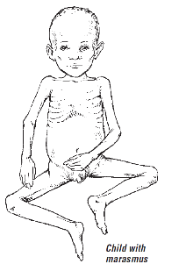
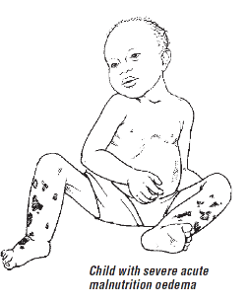
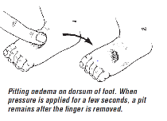
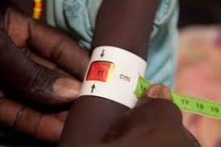
Continue clinical assessment and management
How to manage dehydration in a patient with SAM?
Plan A
Water or ReSoMal as required
At least one measure of maintenance fluids per day PLUS
ReSoMal for every loose stool/vomiting
Plan B
ReSoMal: 10 mL/kg/h for the first 2 hours
5 mL/kg every 30 minutes (per bone or per gastric probe)
then 5–10 mL/kg/h
If possible, alternate administration of ReSoMal and F-75
ReSoMal after every episode of diarrhoea or vomiting PLUS
Water or sweetened water as desired
Plan C (see slide 17)

Slide 32
General supportive care in the Treatment Centre

Slide 33
General supportive care in the Treatment Centre
Administer empiric antimicrobial therapy (within 1st hour). Consider other sources of infection (e.g. malaria)
Check serum glucose, treat if necessary
Check the K⁺ and Mg²⁺ levels and replete if necessary
Treat severe acidosis (pH< 7.2) by treating the underlying problem and consider bicarbonate infusion where appropriate
Consider transfusion of blood products in case of severe anemia, heavy bleeding or coagulopathy
Recognizing, preventing, and treating acute kidney failure
Monitor daily fluid balance
Symptomatic management (e.g. pain, nausea, vomiting, fever)
Start nutritional support and feeding early (if the oral route is tolerated) or via NG if available
Counsel and support patients and their families

Slide 34
General supportive care at the Treatment Centre
Empiric antimicrobial treatment
Appropriate antimicrobial treatment as soon as possible (within 1 hour)
According to the epidemiological context. Antibiotic and antimalarial
Consider FVD specific treatment as soon as possible (if available)

Slide 35
General supportive care at the Treatment Centre
Transfusion
For patients with severe malaria/septic shock: transfuse with red blood cells or whole blood (if applicable)
targets: Hb > 7 g/dL in adults; > 6 g/dL in children (WHO guidelines)
transfuse earlier if further reduction in hemoglobin is expected
signs of coagulation disorders (e.g. disseminated intravascular coagulation, liver failure)
In some cases, fresh frozen plasma +/- platelets may be available
Important: Regularly monitor Hb levels in critically ill patients with confirmed or suspected FVD (e.g. Hemocue – at least 2 times daily).

Slide 36
Summary
During the clinical assessment, be able to recognize the signs suggestive of haemodynamic instability, in particular sepsis, shock, and severe dehydration.
Urgently initiate fluid resuscitation in patients with sepsis and septic shock and adjust according to the cause or context, e.g. malnutrition.
Vasopressors should be available and ready to use when indicated. Do not delay using.
Supervision is needed when giving fluids or vasopressors. Regular reassessment is required to determine targets of perfusion are being met and to avoid volume overload.
Classify patient needs after each reassessment to adjust fluid therapy.
Remember to provide comprehensive care including symptom management (pain, nausea) and antimicrobial therapy to preventing further complications.

Slide 37
Questions?

