Slide 1
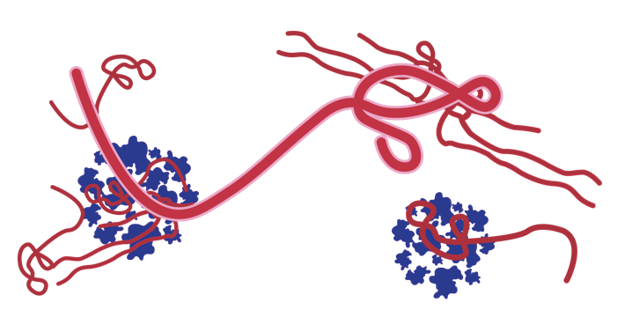
Advanced Filovirus Disease Clinical Management
Introduction to simulation exercise

Slide 2
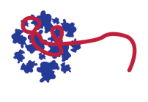
Presentation outline
Arrival at the Treatment Centre and groups distribution
Patient reception, screening and triage
Assessment and emergency care
Documentation, patient follow-up plan and debriefing
FVD therapeutics preparation and administration

Slide 3
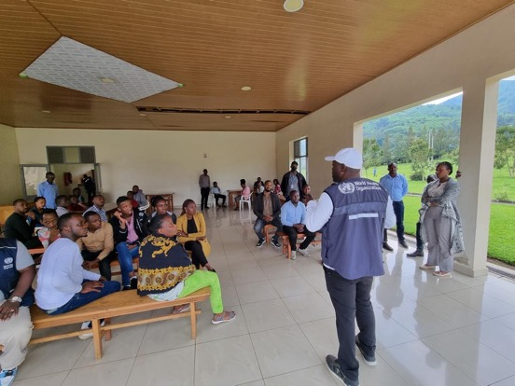
Arrival at the Treatment Centre and group distribution

Slide 4




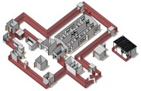
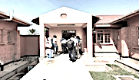



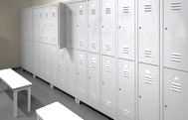

30 min
Upon arrival, at the simulation site, quickly divide the trainees into random groups with one medical facilitator per group.
PS: groups can also be formed in the training room
1
2
3
1
2
3
1
2
3
Count from 1 to 3 to form the groups.
Group 1 + Facilitator
Group 2 + Facilitator
Group 3 + Facilitator
Direct the trainees to the changing room so that everyone is dressed in the low-risk area uniform, scrubs and boots.

Slide 5

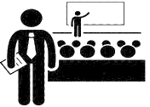






15 min
Each group chooses a leader, who will assign the members of the group to different positions, with the help of the facilitator.
The leader of the group receives the various materials and medical products for the low-risk area.
He can be assisted by a group member to make them available when necessary.
With the help of the facilitator, the participants choose a group leader (5 min)
The manager distributes the tasks according to the different positions (5 min)
The facilitator gives him the package of materials and drugs (2 min)
The IPC/WASH facilitator manages the dressing area, bringing one member from each group to help the others dress (hygienist)
Dressing area
Each IPC officer in the group takes his pack of PPE (5 min)

Slide 6

The group facilitator informs the group to start preparing the admission of a patient and his caretaker, who is arriving in 10 to 15 minutes
GO

Slide 7
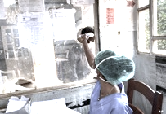



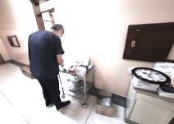

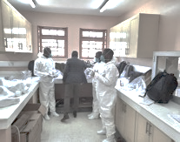
15 min
The screening officer goes to his post
A clinician prepares the necessary material for the management of the patient, as well as the necessary forms
The facilitator takes the patient and his caretaker aside to brief them on the course of the scenario
Clinicians assigned to the high-risk area go to the donning area to put on full PPE

Slide 8
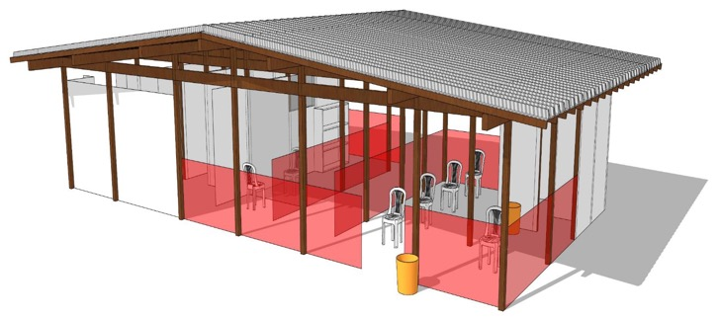
Scenario 1 Patient reception, screening and triage

Slide 9
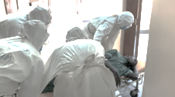
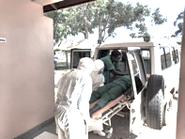
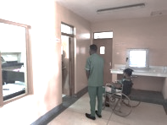

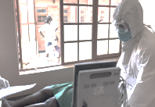

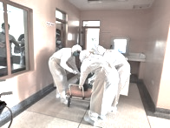
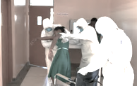
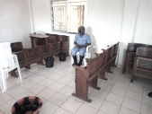
15 min
Quickly transport the patient to the room
High-risk area clinicians get the patient out of the ambulance
Rapid screening (If patient does not communicate, ask caretaker)
OR
At the same time, 2 clinicians from the low-risk area will stand at the window of the room
The patient with caretaker arrives either by walking or in the ambulance.
Support the patient and place him in the wheelchair
Triage: High-risk clinicians observe danger signs to initiate urgent management
The accompanying person remains in the screening or waiting room, for screening

Slide 10
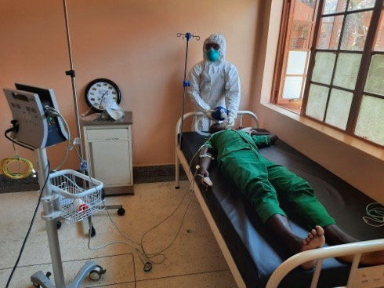
Scenario 2 Assessment and emergency care
PS: Participants who finish their roles join the others in the patient's room or the window to observe the course of the scenario

Slide 11
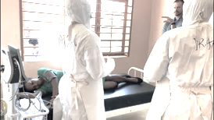
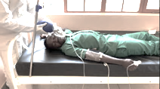
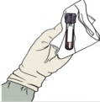
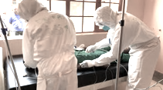
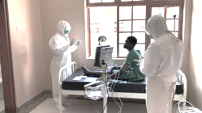
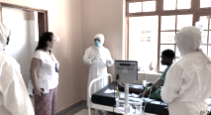
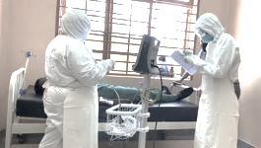
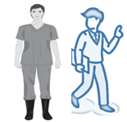
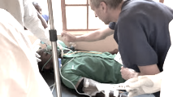
30 min
Collect the blood sample collection.
PS: The facilitator can give a tube containing iodized alcohol.
Assessment and clinical management by communicating with colleagues in the low-risk area
Once the patient is stabilized. Compliance of clinical information is done with the low-risk team
The facilitator reminds the hygienist (who is in the room as an observer) to go to the doffing area
The facilitator gives instructions to the patient to simulate clinical signs and parameter values to clinicians
The facilitator can correct some skills during the session

Slide 12
Scenario 3 Documentation, patient follow-up plan and debriefing

Slide 13
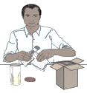
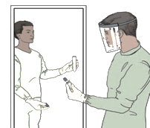
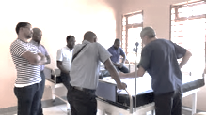
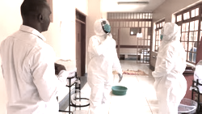
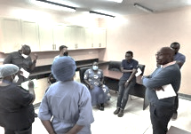
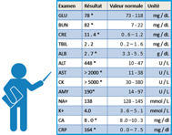
45 min
Green zone clinician Finishes triple wrapping
Discussion of laboratory results and patient treatment plan.
Transport of the blood sample from the high-risk area to the low-risk area
Meeting room
Participants from 2 zones compare the information received.
Doffing of the high-risk team with the "hygienist" and help from the IPC/WASH facilitator
Session Debrief Opportunity
The facilitator gives the printout of the laboratory results, including a positive Ebola PCR

Slide 14
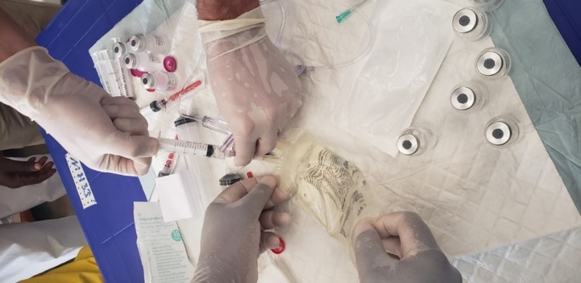
Scenario 4 FVD therapeutics preparation and administration

Slide 15
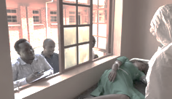
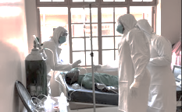
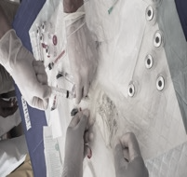
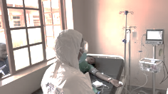
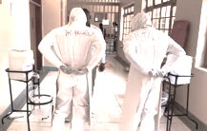
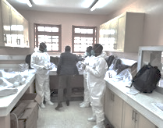
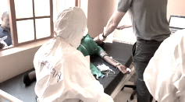

60 min
3 clinicians outside the patient room
Participants will manage side effects
2 clinicians in light PPE, prepare one of the molecules
Those in the high-risk area, assess the patient and start the infusion
Patient stabilized, they put off the PPE and go out
3 clinicians will dress in full PPE
Facilitator asks patient to simulate a "side effect"
General debriefing

Slide 16



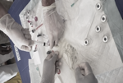

Remember
ALL the process: cleaning, MHPSS, decontamination and patient feeding
Triage
Clinical assessment
Monitoring and follow-up
Treat and re-assess
Screening
1
2
3
4
5
Reception of lab results and discussion in medical team
Determine if patient in high risk of complications.
Re-adjust monitoring and treatment plan
Tool: Daily assessment form, Assessment checklist
Assess the patient (ABCD) and manage emergency.
Take blood sample (FVD PCR and others tets)
A medical team in low-rsik zone to collect information
Define initial monitoring and treatment plan
Tool: Admission form
Start of admission process. Check emergency or danger signs/symptoms.(20 sec) Refer patient to the appropriate service or room (e.g ICU)
Tool: Inter-agency triage tool
Quickly decide if the patient is FVD suspect or not. Tool: FVD Case definition algorithm and screening form

