Slide 1

Optimized supportive care for FVD: Care for special populations

Slide 2
23.
Newborn care

Slide 3



Life-saving management strategy for FVD patients: three key interventions
Design and biosecurity of Treatment Centre
Optimized supportive care
Specific therapeutics
(depends on the causative virus)
A facility focused on patients, staff, families and communities
A facility where patients can get quality care, compliant with all biosecurity standards and IPC is available
Systematic assessment and monitoring of patients
Resuscitation with oral and IV fluids
Availability of point-of-care tests (biochemistry, electrolytes, haemoglobin) and use of oxygen and blood products
Prevention and care of complications
Recommendation for the treatment of EBOV (Zaire ebolavirus) with:
    Ansuvimab (mAb114, Ebanga)
    Atoltivimab, maftivimab, odesivimab “cocktail” (REGN-EB3, INMAZEB)
Specific therapeutics for other Ebolaviruses and Marburgviruses currently in development

Slide 4
Learning objectives
At the end of this session you will be able to:
1.
2.
3.
Understand how to prepare a Treatment Centre to care for newborns
Describe the infection prevention precautions needed to care for newborns in the context of FVD
Discuss the principles of essential care of a newborn born in FVD context

Slide 5
1.Preparing the Treatment Centre

Slide 6
Preparing the Treatment Centre
Structure
Supplies
Staff
Security
System

Slide 7
Preparing the Treatment Centre
Structure
    Specific areas for midwifery, obstetrics, newborn and intensive care
    Rooms adapted and equipped for neonatal resuscitation and newborn care
    "Nursery" integrated into the Treatment Centre
Structure
Supplies
Staff
Security
System

Slide 8
Preparing the Treatment Centre
Supplies
    Resuscitation equipment (ABCD) – adult and neonatal.
    Obstetric kits
    (e.g. normal, assisted vaginal birth, caesarean, management of complications including abortion, postpartum haemorrhage)
Structure
Supplies
Staff
Security
System

Slide 9
Preparing the Treatment Centre
Staff
    Experienced staff in midwifery, obstetrics, newborn and intensive care
    Ensure doctors and nurses are trained on FVD optimized supportive care, obstetric care, neonatal care
Structure
Supplies
Staff
Security
System

Slide 10
Preparing the Treatment Centre
Security
    Apply standard precautions and FVD-specific Infection Prevention Control (IPC) measures for management of pregnant women and their babies
Structure
Supplies
Staff
Security
System

Slide 11
Preparing the Treatment Centre
System
    Rapid screening mechanism for pregnant women and admission
    Systematic initial triage and clinical assessment
Structure
Supplies
Staff
Security
System

Slide 12
2.Essential newborn care

Slide 13
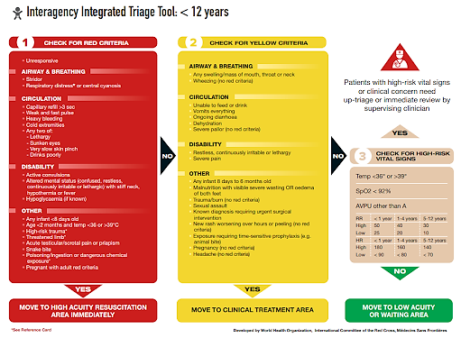
Management of newborn and infants
Screen, triage, clinical assessment and care

Slide 14
Resuscitation of newborn
A newborn born to an FVD confirmed mother or who is born in an FVD Treatment Centre is assumed FVD-positive and care provided should be in accordance with full PPE and IPC protocols
      !

Slide 15
Resuscitation of newborn
A newborn born to an FVD confirmed mother or who is born in an FVD Treatment Centre is assumed FVD-positive and care provided should be in accordance with full PPE and IPC protocols
Rapid RT-PCR FVD testing of the newborn should be prioritized
      !

Slide 16
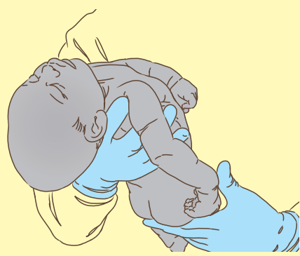
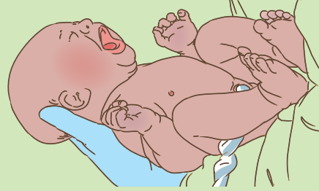
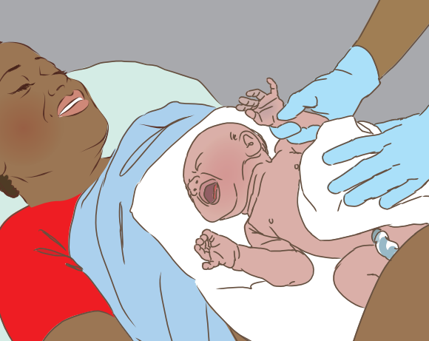
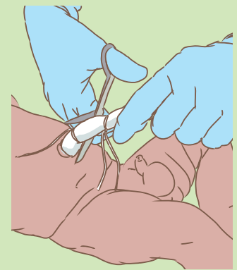
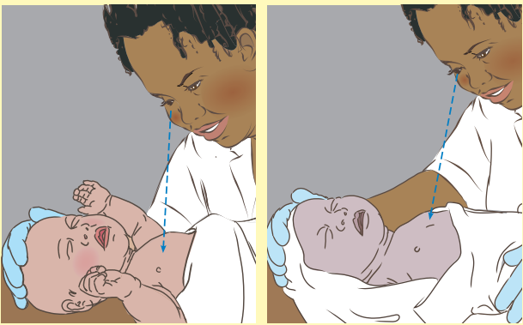
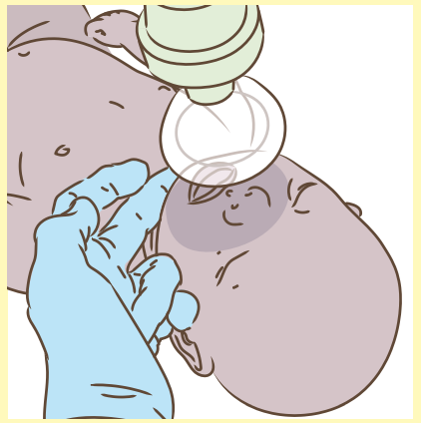
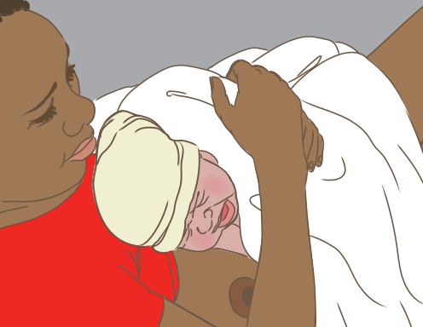
Resuscitation of newborn
Immediately after birth
Dry the baby with a clean cloth and keep warm
Keep the baby warm
Neutral head position
and clear airways
Aspiration only if secretions are visible
Stimulation
Golden minute
After 1–3 min from birth
Observe breathing
Check breathing, keep baby warm
Hand over the baby to the mother
      !
If the mother has confirmed FVD, if possible, prior to birth – discuss with mother/family risks vs benefits of separating the pair directly after childbirth

Slide 17
Resuscitation of newborn
Immediately after birth
Dry the baby with a clean cloth and keep warm
If resuscitation is necessary and impossible near the mother, cutting the cord can be done
Keep the baby warm
Neutral head position
and clear airways
Aspiration only if secretions are visible
Stimulation
Golden minute
After 1–3 min from birth
Observe breathing
Check breathing, keep baby warm
Hand over the baby to the mother
      !

Slide 18
Resuscitation of newborn
Immediately after birth
Dry the baby with a clean cloth and keep warm
Keep the baby warm
Neutral head position
and clear airways
Aspiration only if secretions are visible
Stimulation
If the mother has confirmed FVD, if possible, prior to birth – discuss with mother/family risks vs benefits of separating the pair directly after childbirth
Golden minute
After 1–3 min from birth
Observe breathing
Check breathing, keep baby warm
Hand over the baby to the mother
      !

Slide 19
Essential Newborn Care
Dry and keep baby warm (Kangaroo-mother-care not easy)
Resuscitation when needed
Umbilical cord care – apply chlorhexidine and sterile compress
Do not initiate breastfeeding until PCR results are known
Give Vitamin K
Provide eye care with tetracycline
Manage infections
Clinical assessment
Nurturing care – if mother too sick, consider other family members
Recognize and respond to danger signs
      !

Slide 20
Essential Newborn Care
Dry and keep baby warm (Kangaroo-mother-care not easy)
Resuscitation when needed
Umbilical cord care – apply chlorhexidine and sterile compress
Do not initiate breastfeeding until PCR results are known
Give Vitamin K
Provide eye care with tetracycline
Manage infections
Clinical assessment
Nurturing care – if mother too sick, consider other family members
Recognize and respond to danger signs
While awaiting PCR results, if mother is well enough encourage mother to start expressing milk to establish supply if she wants to have the option of BF when test results back
      !

Slide 21
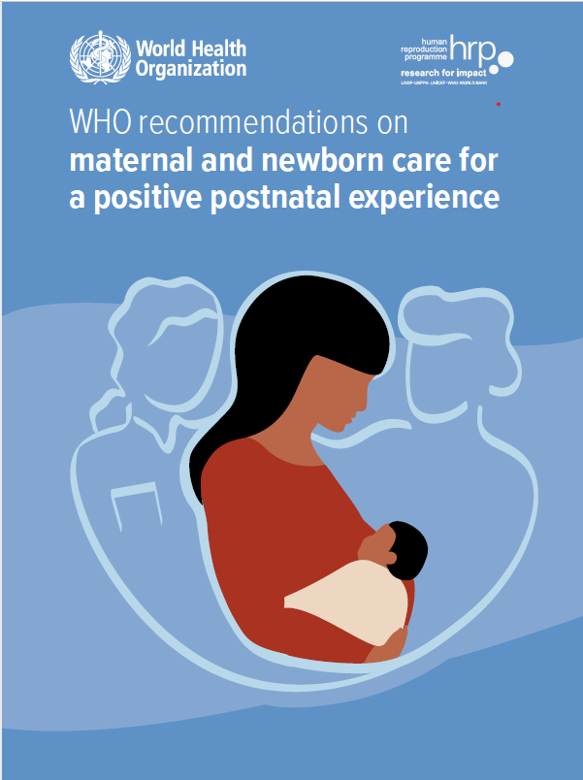
Essential Newborn Care
Dry and keep baby warm (Kangaroo-mother-care not easy)
Resuscitation when needed
Umbilical cord care – apply chlorhexidine and sterile compress
Do not initiate breastfeeding until PCR results are known
Give Vitamin K
Provide eye care with tetracycline
Manage infections
Clinical assessment
Nurturing care – if mother too sick, consider other family members
Recognize and respond to danger signs
      !
https://www.who.int/teams/maternal-newborn-child-adolescent-health-and-ageing/newborn-health/essential-newborn-care

Slide 22
Re-assess and monitor
Assess the mother’s condition: If the mother's FVD RT-PCR is positive
Monitor closely for these parameters regularly:

Slide 23
Re-assess and monitor
Monitor closely for these parameters regularly:
Assess the mother’s condition: If the mother's FVD RT-PCR is positive
Monitor closely for these parameters regularly:
Airway and Breathing
Circulation

Slide 24
Re-assess and monitor
Monitor closely for these parameters regularly:
Airway and breathing
Assess the mother’s condition: If the mother's FVD RT-PCR is positive
  Respiratory distress
Monitor closely for these parameters regularly:
Apnoea
  SpO₂
  RR+/-
Airway and Breathing
Circulation

Slide 25
Re-assess and monitor
Monitor closely for these parameters regularly:
Circulation
  Signs of hypoperfusion
Assess the mother’s condition: If the mother's FVD RT-PCR is positive
  Signs of dehydration
  HR +/-
Monitor closely for these parameters regularly:
Palor
Airway and Breathing
Circulation

Slide 26
Re-assess and monitor
Assess the mother’s condition: If the mother's FVD RT-PCR is positive
For EVD: Administer specific monoclonal antibodies if available
Assess the mother’s condition: If the mother's FVD RT-PCR is positive
      !
Monitor closely for these parameters regularly:

Slide 27
Re-assess and monitor
Assess the mother’s condition: If the mother's FVD RT-PCR is positive
For EVD: Administer specific monoclonal antibodies if available
Assess the mother’s condition: If the mother's FVD RT-PCR is positive
      !
Monitor closely for these parameters regularly:
Indication for EBOV Zaire
Neonates < 7 days old, without PCR-confirmed EVD, born to mothers with
PCR-confirmed EVD

Slide 28
Re-assessment and monitoring
All newborns should be evaluated immediately; the following danger signs warrant immediate treatment:
Danger signs
WHO recommendations on maternal and newborn care for a positive postnatal experience, WHO, 2014

Slide 29
Re-assessment and monitoring
All newborns should be evaluated immediately;
the following danger signs warrant immediate treatment:
Not feeding well
History of convulsions
Fast breathing (RR > 60 per minute);
Severe chest in-drawing; no spontaneous movement
Fever (temperature > 37.5 °C);
Low body temperature (temperature < 35.5 °C);
Bulging fontanelle
Jaundice
Laboratory test: Hb, hypoglycaemia (< 45 mg/dL)
All newborns should be evaluated immediately; the following danger signs warrant immediate treatment:
Danger signs
WHO recommendations on maternal and newborn care for a positive postnatal experience, WHO, 2014

Slide 30
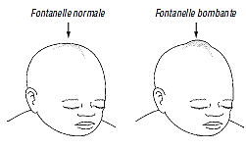
Re-assessment and monitoring
All newborns should be evaluated immediately;
the following danger signs warrant immediate treatment:
Not feeding well
History of convulsions
Fast breathing (RR > 60 per minute);
Severe chest in-drawing; no spontaneous movement
Fever (temperature > 37.5 °C);
Low body temperature (temperature < 35.5 °C);
Bulging fontanelle
Jaundice
Laboratory test: Hb, hypoglycaemia (< 45 mg/dL)
All newborns should be evaluated immediately; the following danger signs warrant immediate treatment:
Danger signs
WHO recommendations on maternal and newborn care for a positive postnatal experience, WHO, 2014

Slide 31
Reassess, monitor, and treat
Oxygen (babies on O₂ should be monitored with pulse oximeter)
Severe neonatal infection: antibiotics
Apnoea in premature babies
Newborn nutrition

Slide 32
Reassess, monitor, and treat
Severe neonatal infection: antibiotics
  Consider ampicillin/cefotaxime or flucloxacillin/cefotaxime
  Adapt to the clinical picture, e.g.: necrotizing enterocolitis, skin lesions or of meningitis
Oxygen (babies on O₂ should be monitored with pulse oximeter)
Severe neonatal infection: antibiotics
Apnoea in premature babies
Newborn nutrition

Slide 33
Reassess, monitor, and treat
Oxygen (babies on O₂ should be monitored with pulse oximeter)
  1–2 L O2 per min, humidification if > 1 L/min. SpO2 target: 90–95%
  Consider b-CPAP for RDS
Oxygen (babies on O₂ should be monitored with pulse oximeter)
Severe neonatal infection: antibiotics
Apnoea in premature babies
Newborn nutrition

Slide 34
Reassess, monitor, and treat
Apnoea in premature babies
  Premature newborn ≤ 36 weeks: Treat episodes > 20 sec and/or association with bradycardia and/or desaturations
  Premature > 34 weeks or birth weight < 1500 g:
    Apnoea prevention with Caffeine citrate, otherwise aminophylline.
    Surveillance: SpO2 and HR and/or apnea detector (if available)
Oxygen (babies on O₂ should be monitored with pulse oximeter)
Severe neonatal infection: antibiotics
Apnoea in premature babies
Newborn nutrition

Slide 35
Preparing for discharge
Head to Toe assessment
Communication with parents and family
Educate parents on newborn care at home
Discharge kit: bednets, BMS, hygiene items, food rations
Newborn vaccination
Follow up visit planning

Slide 36

Preparing for discharge
Head to Toe assessment
Communication with parents and family
Educate parents on newborn care at home
Discharge kit: bednets, BMS, hygiene items, food rations
Newborn vaccination
Follow up visit planning

Slide 37
Famiy Centred Care
Consider care of orphans; liaising with families and social support services (and NGOs)
Healthcare and community support for mothers/families with young children and newborns after leaving the Treatment Centre
“Day care" integrated into the Treatment Centre

Slide 38
Famiy Centred Care
“Day care" integrated into the Treatment Centre
    Explore opportunities to provide safe, reliable childcare for children with parents hospitalized
Consider care of orphans; liaising with families and social support services (and NGOs)
Healthcare and community support for mothers/families with young children and newborns after leaving the Treatment Centre
“Day care" integrated into the Treatment Centre

Slide 39
Daily
knowledge check

Slide 40
Knowledge check
Question 1
In the care of a woman and her newborn at the Treatment centre, which of these practices is not advisable to implement directly?
(click a field to answer)
Tetracycline ophthalmic care of the newborn
  Umbilicus care with Chlorhexidine
  Prevention of hypothermia through skin-to-skin contact (mother-baby)
Administration of vitamin K1
submit

Slide 41
Knowledge check
Question 1
In the care of a woman and her newborn at the Treatment centre, which of these practices is not advisable to implement directly?
(click a field to answer)
Tetracycline ophthalmic care of the newborn
  Umbilicus care with Chlorhexidine
  Prevention of hypothermia through skin-to-skin contact (mother-baby)
Administration of vitamin K1
Correct
That’s right! You chose the correct response.
submit

Slide 42
Knowledge check
Question 2
In what order would you consider these steps in the resuscitation of the newborn just after delivery?
Keep warm
Ventilate
Stimulate
Clearing the airway
  1,2,3,4
  3,1,2,4
  2,4,3,1
1,4,3,2
submit

Slide 43
Knowledge check
Question 2
In what order would you consider these steps in the resuscitation of the newborn just after delivery?
Keep warm
Ventilate
Stimulate
Clearing the airway
  1,2,3,4
  3,1,2,4
  2,4,3,1
1,4,3,2
Correct
That’s right! You chose the correct response.
submit

Slide 44
References
https://www.who.int/teams/maternal-newborn-child-adolescent-health-and-ageing/newborn-health/essential-newborn-care
WHO recommendations on maternal and newborn care for a positive postnatal experience, WHO, 2014
Pediatric Hospital Care: Managing Common Conditions in Small Hospitals, World Health Organization, 2007. Available at https://apps.who.int/iris/handle/10665/43551

